Slide 1
CAC Meeting
July 14, 2020
COVID-19 Update
Notes:
Good afternoon Madam Chair and Members of the CAC. I will be providing the COVID-19 update today and I will begin with a brief update to our incident timeline.

Slide 2
Incident Timeline Updates
July 5 – Access monitors the Soledad Fire and initiates a detour for transfer vehicles to Sierra Highway to avoid the closure of the SR-14 freeway.
July 6 – Access implements first step of service restoration plan with limited physically distanced shared rides on transfer trips to and from the Antelope Valley.
July 17 – Last day of meal delivery program with City of Los Angeles Department on Disability and Khalsa Care Foundation.
Notes:
On July 5th, Access monitored the Soledad Fire, which burned approximately 1,100 acres and resulted in the closure of all lanes of the SR-14 freeway connecting the Antelope Valley to LA basin. Access Operations, working with Keolis, our Antelope Valley Region contractor, re-rerouted transfer vehicles to Sierra Highway to avoid the closure. All four riders with transfer trips at the time of the incident safely completed their transfer trips with little to no impact.
On July 6th, Access implemented our first service restoration item by allowing physically distanced shared rides on our largest cutaways for transfer trips to/from the Antelope Valley only. I will provide more details about this on an upcoming slide.
On July 17th, the meal delivery program with LA DOD and KCF will come to an end; for several months, the program delivered roughly 3,000 meals a day to seniors and people with disabilities in the city.

Slide 3
Delivery Operations
Access has five current meal, grocery, and paper goods delivery projects and has made 193,814 total deliveries through Wednesday, July 8th.
Delivery operations remain ongoing in five service regions.
Meal delivery program with the Los Angeles Department on Aging has been extended through July 2020.
Notes:
In terms of delivery operations, Access has completed 193,814 through Wednesday, July 8 across our five current delivery projects.
Delivery operations continue to be ongoing with five of the six service regions engaged.
Our meal delivery program with the Los Angeles Department on Aging has been extended through the end of July.
And as I said, the meal delivery program with the Los Angeles Department on Disability will come to an end on July 17.

Slide 4
Same Day Service Update
As of Wednesday, July 8, Access has completed 5,608 same-day trips since the program was implemented on May 4.
The busiest day for same day trips occurred on July 2 with 160 total trips.
As of Wednesday, July 8, Access has completed 7 total curbside pick up trips since the program was implemented on June 8.
Notes:
In terms of the same-day service pilot program, Access has completed 5,608 same-day trips to date as of last Wednesday, July 8. We also had our highest one day total of same day trips on July 2nd with 160 total same day trips that day.
As of Wednesday, July 8, Access has completed 7 total curbside pick up trips since the program was implemented on June 8.

Slide 5
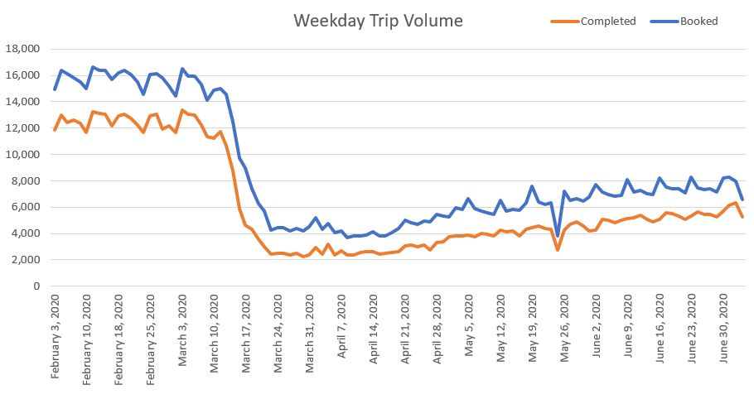
Impacts on Ridership
Notes:
Now onto impacts on ridership. The graph on this slide depicts a slightly upward trend in booked and completed trips since May, however we continue to operate at a significantly lower trip volume than pre-pandemic levels. By the end of June, ridership was about 40% of what it was prior to the pandemic.

Slide 6
What We Now Know about COVID-19
Transmission of COVID-19
Mainly from person-to-person who are in close contact with one another.
Through respiratory droplets produced when an infected person coughs, sneezes, or talks.
Asymptomatic carriers.
Protect Yourself from COVID-19
Wear a face covering.
Routine hand washing and sanitization.
Physical distancing.
Source: US Centers for Disease Control and Prevention (CDC)
Notes:
Public health officials have learned a lot of about COVID-19 over the past few months, and while a lot remains unknown, we wanted to share some of what we now know about COVID-19, which is informing how we approach the safe restoration of service.
The virus is now thought to spread mainly from person to person among people who are in close contact with one another and through respiratory droplets from one person that land in the mouth, nose, or eyes of another person following a cough, sneeze, or while talking or singing. COVID-19 can also be spread through people who are not showing symptoms, or asymptomatic carriers. Duration of the close contact is also thought to be a factor for transmission.
Touching a surface with the virus is NOT thought to be the main way the virus spreads.
The best known protection from COVID-19 is to wear a cloth face covering, which can help prevent the spread of the respiratory droplets that contain the novel coronavirus, routinely wash your hands, and practice good physical distancing whenever possible.

Slide 7
Service Restoration Factors
Demobilize mid-day vehicle disinfection.
Reduce delivery services.
Eliminate same day service pilot program, including curbside pick up.
Relocate the North County Transfer Point back to Olive View Medical Center.
Reduce/eliminate non-shared ride service.
Notes:
Recovery and service restoration continue to be a focus of Access. The goal of restoring service back to pre-pandemic service levels will be to balance operational circumstances and guidance from our public health partners. These factors will be implemented over time depending on operational circumstances and the pandemic situation in Los Angeles County. The general service restoration factors are…
Access is looking at demobilizing mid-day vehicle disinfection within the next month.

Slide 8
Share Ride Service Restoration Factors
Reinstate limited shared rides to large vehicles (two rider maximum on cutaways).
Reinstate limited shared rides on all vehicles (two riders maximum on all vehicles; one mobility device maximum).
Reinstate all shared rides with a one mobility device maximum on minivans.
Reinstate all shared rides with no limitations.
Notes:
With regard to share ride service, there are four service restoration factors.
The first one – to reinstate limited shared rides to large vehicles with a two rider maximum on cutaways – has been implemented on a limited basis on transfer trips to/from the Antelope Valley only. These shared rides occur on our largest vehicles and have a limit of 2 riders per cutaway to adhere to six foot physical distancing measures. One PCA or guest can ride for a maximum of three persons onboard at a time. The reservationist will advise the rider that their transfer trip could be limited shared ride at the time of booking. Local service in the Antelope Valley will continue to operate with no share rides at this time.
The other share ride service restoration factors include…

Slide 9
Other Factors
Continue to build inventory of extra PPE.
Maintain communications with major activity centers to monitor re-openings.
Reinstate restricted addresses and recovered riders.
Notes:
Lastly, three other recovery factors include:
I will also add that we are already providing masks to riders who do not have one at the time of their trip or may not have access to one.

Slide 10
Thank you! Questions?
Notes:
And with that, I’m happy to take any questions that you may have.

