Slide 1
Emergency Management Update
Community Advisory Committee
April 11, 2023
Notes:
Good afternoon Madam Chair,
It is good to be back before the committee today. For those who have not met me already, my name is Alex Chrisman. I am the Emergency Management Coordinator for Access, responsible for maintaining the Agency’s emergency preparedness and situational awareness. I formerly served Access as a Project Administrator. I will be providing an update on Access Emergency Management.
Next slide please…

Slide 2
Face covering update
Face coverings no longer required for riders and drivers
Riders asked not to ride while sick
Daily vehicle cleanings still occurring
Notes:
First, an update regarding Covid-19. As of the 31st of last month, the emergency declaration in Los Angeles County ended. As a result, face coverings are now optional on Access. Riders are encouraged not to ride while sick. Daily vehicle cleanings are still occurring. We thank the community for its cooperation over the past three years.
ONLY IF ASKED, HERE ARE THE EXPIRATION DATES FOR THE COVID EMERGENCY DECLARATIONS
The City of Los Angeles ended their emergency status on: 2/1/23
The State of California has announced an end to the emergency effective: 2/28/23
The federal government has announced an end to the emergency effective: 5/11/23
Next Slide please

Slide 3
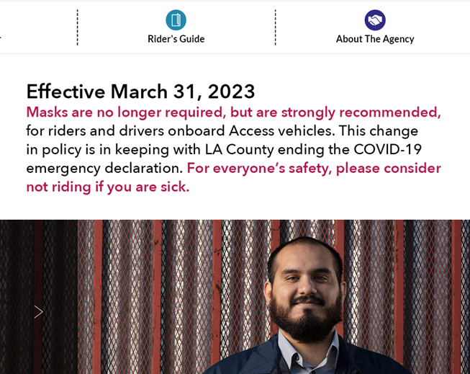
Messaging to riders
Website banner and email blast
Phone line hold messages
Infoline messages
Where’s My Ride Message
Notes:
Access informed riders starting March 16th of the changes via our website and phone hold messages as well as via the Access Infoline. We also sent out an email blast to those who subscribe to our email updates. Additionally, we sent a message via the Where’s My Ride app. The photo shows a screenshot of the Accessla.org website with a message about masks no longer being required.
Next Slide please

Slide 4
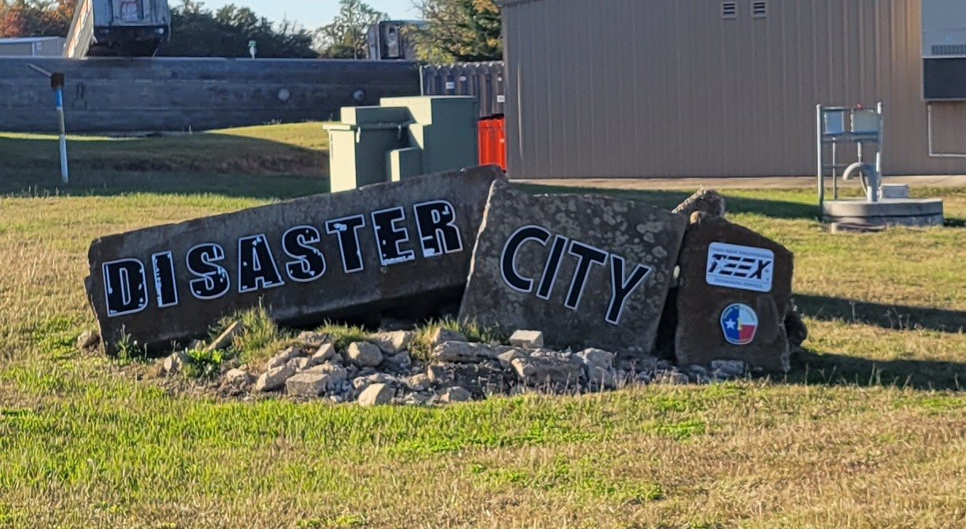
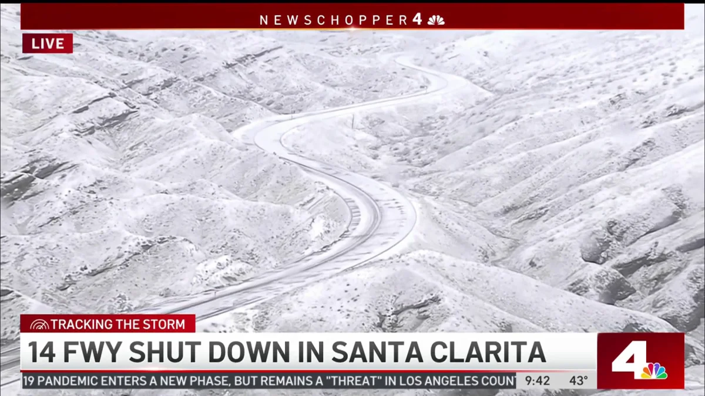
Constant vigilance
Monitor media and emergency management sources daily
Frequent training
Tabletop exercise planned
Notes:
When it comes to emergency preparedness, it is important to always be vigilant. Staff monitors the media and other sources daily to assess any potential impacts to the service. We then take action regarding the information as appropriate and make sure that our contractors are informed. During the recent winter storms, staff monitored and worked with our contractors to ensure that rider impact was minimal. We activated our Emergency Operations Center to better leverage staff resources. Our transfer trip service between the basin regions and the Antelope Valley and Santa Clarita was impacted by the storms, with the State Route 14 Freeway closing at one point. Our EOC operations helped keep the big picture in mind while our contractors focused on the street-level details. The photo shows the 14 freeway surrounded by snow and ice.
We also train frequently. Operations staff are required to take a minimum of 3 Incident Command System courses. We also receive specialized training, such as the training on emergency operations center functions and tsunami awareness. The photo shows the entrance to Disaster City, in College Station, Texas, where I was able to partake in EOC training in a highly advanced environment with world-class instructors. Training like this helps me and the Agency prepare for whatever might come our way. Building on this effort, we are planning a tabletop exercise in house to maintain readiness in the near future.
Next Slide please

Slide 5
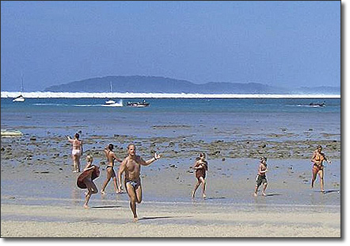
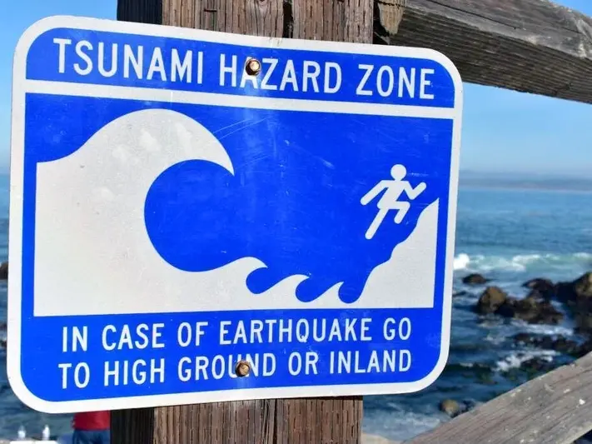
Tsunami awareness
Immediately head for high ground during earthquake
Do not linger
If the water recedes, leave
Notes:
Speaking of tsunamis, the overall risk is low in our area compared to up north near Seattle and elsewhere in the world. However, if there is an earthquake or you see waters recede, do not linger near shore. Immediately head for higher ground. It is possible that low lying areas of our region could be impacted by a large wave, reaching up to 15 feet above sea level. The photo shows a group of people near shore, after waters had receded, with a large wave visible in the background. This turned out to be the Indian Ocean tsunami of 2004, which killed over 227,000 people. The other photo shows a blue tsunami evacuation route sign, which is used by some local cities to mark tsunami evacuation routes. Our local partners are preparing the possibility of a tsunami.
Next Slide please

Slide 6
Preparedness Planning
Internal plans updated yearly
Includes Continuity of Operations, Emergency Operations, Pandemic and Emerging Infectious Diseases, Severe Weather and others
Collaboration with local, state and federal agencies
Notes:
When it comes to preparedness, you get what you plan for. Based on this, Access maintains a host of internal plans related to emergency preparedness. I’ll highlight our continuity of operations plan. The COOP plan, as it is called, allows the agency to be resilient in times of disaster. It identifies in advance qualified personnel who may take on executive roles in the event one of our key executive staff members is not available. Alternative operating locations for our contractors are also laid out as well as plans to relocate Access headquarters. This focus on pre-planning, which is standard in the emergency operations world, enables the agency to carry on it’s important work even when unexpected events occur. This was highlighted during the Covid-19 pandemic, when the agency and its contractors was able to pivot to meal delivery and vaccination transportation during low ridership periods. Our relationships with local emergency management agencies was pivotal during that time. We worked closely with the City and County of Los Angeles, setting up vaccination drive through sites and providing meals to those who needed them. At one point, the Mayor of Los Angeles mentioned Access on television regarding the meals. We also worked with the state and federal government, both of which were involved in the Cal State Los Angeles drive through vaccination site through FEMA and CalOES. Finally, we were able to obtain reimbursement from FEMA for our special pandemic services. This was only possible due to the attention to detail of our operations and finance teams, and the knowledge that Access has in-house regarding disaster documentation.
With that, I thank you for your time. Madam Chair, I am available for any questions.
Next Slide please

