Slide 1
Eligibility Services Contract Scope

Slide 2
Contract Overview
Contract Overview
Medical Transportation Management (MTM)
July 2017 - June 2024
Three (3) years with two (2) two (2) year renewal option years
Not to exceed seven (7) years
Contract Volume: Year 2019 Statistics
In Person evaluations 33,705
Paper evaluations 21,072
Marking and Tethering 3,176

Slide 5
RFP Schedule
ITEM | DATE
Committee/Board Review | March/April 2023
Issue RFP | July 5, 2023
Proposals Due | September 13, 2023
Board Committee | November 2023
Board Contract Award | December 2023
Service Begins | July 1, 2024

Slide 6
Scope of Work
Three (3) years with two (2) two (2) year renewal option years
Initial application, functional assessment, marking and tethering, and safety orientation
Main site in Commerce with satellite sites in Santa Clarita and Antelope Valley
Assessment scheduling with transportation provider

Slide 7
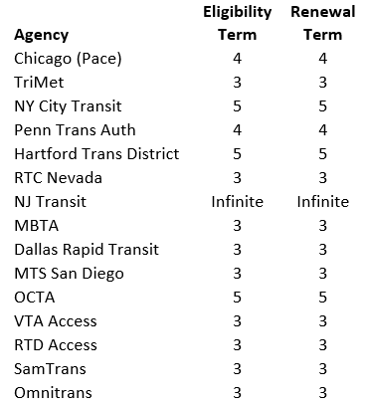
Eligibility Survey

Slide 8
Scope of Work Change
Eligibility Term - 3 years to 5 years
Based on feedback from Community Advisory Subcommittee
15 Paratransit agencies were surveyed
Reduced paperwork requirement for riders
$11-13 million dollars savings over 15-year period

