Slide 1
Operations Update
Community Advisory Committee
January 10, 2023
Notes:
Good afternoon Madam Chair, members of the committee and audience in attendance. I will be presenting today’s Operations Update for the month of January.
Next slide please

Slide 2
Statistics
 | November 2021 | November 2022 | % Change
Vehicle Trips Completed | 193,082 | 229,164 | +19%
Passenger Trips Completed | 244,797 | 284,596 | +16%
Reservation Calls Answered | 157,567 | 170,249 | +8%
ETA Calls Answered | 41,760 | 42,784 | +3%
WMR ETAs Requested | 264,156 | 366,510 | +39%
Notes:
We’ll start with some overall performance statistics based on November 2022, the latest month we have data for. This slide shows a comparison of Vehicle Trips Completed, Passenger Trips Completed, Reservation Calls Answered, ETA Calls Answered and Where’s My Ride ETA Requests for November 2021 and November 2022.
For the month of November 2022, over 229,000 vehicle trips were completed. This is a 19% increase compared to the previous November. In addition, there were also over 284,000 passenger trips completed. There were also over 170,000 reservation calls answered and over 42,000 ETA calls answered. We also continue to see strong use of the Where’s My Ride app for estimated time of arrival requests, with over 366,000 Where is My Ride ETAs requested which are up 39% from last year.
Next Slide Please

Slide 3
Performance Report Card
Key Performance Indicator | Standard | November 2022 | FY23 through November 2022
On Time Performance | ≥ 91% | 90.2% | 90.6%
Excessively Late Trips | ≤ 0.10% | 0.08% | 0.06%
Excessively Long Trips | ≤ 5% | 4.1% | 4.2%
Missed Trips | ≤ 0.75% | 0.52% | 0.49%
Denials | ≤ 0 | 0 | 2
Access to Work On Time Performance | ≥ 94% | 94.7% | 95.1%
Average Hold Time in seconds (Reservations) | ≤ 120 | 68 | 68
Calls On Hold > 5 Min (Reservations) | ≤ 5% | 3.0% | 2.7%
Calls On Hold > 5 Min (ETA) | ≤ 10% | 2.9% | 2.3%
Complaints Per 1,000 Trips | ≤ 4.0 | 2.9 | 3.2
Preventable Incidents per 100,000 Miles | ≤ 0.25 | 0.23 | 0.24
Preventable Collisions per 100,000 Miles | ≤ 0.75 | 0.75 | 0.83
Miles Between Road Calls | ≥ 25,000 | 37,898 | 45,695
Green is good, yellow is cautiously optimistic, red is not meeting standard
Notes:
Looking at the systemwide performance report card, we had a very strong November 2022 where we met 12 of the 13 Key Performance Indicators. Average hold time finished at 68 seconds, excessively late trips ended at 0.08%, and missed trips ended at 0.52% to just name a few.
The one KPI that was not met in November was On Time Performance which concluded at 90.2%. This was due to increased service demand and resource challenges.
*If Asked (The preventable collision trend is high for the year due to curbing incidents, however in an effort to limit curbing, Access created a video that was sent to the contractors to assist with contractors’ ongoing campaigns. These occurrences are trending down after these efforts which we can see in November’s data.)
*If Asked about denials (Both occurrences occurred in September in the Northern Region and Santa Clarita Region. SC’s was caused by a call taker error; they took it upon themselves to enter a different time for the customer. Call taker has been retrained to proficiency. MV’s was caused by a call taker error; call taker offered two times outside of the negotiation window. Call taker has been retrained to proficiency. )
Next slide please

Slide 4
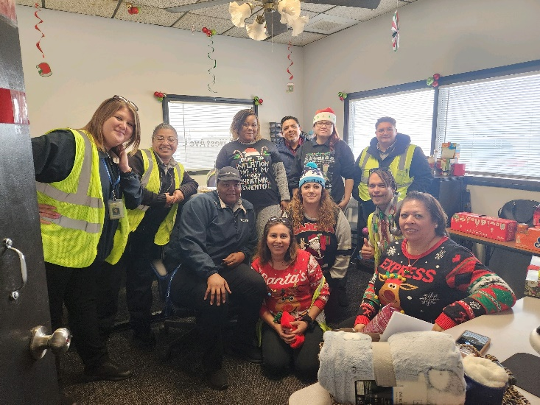
Highlights
The Board approved the Public Transportation Agency Safety Plan for Access
Metro released a Board report outlining priority projects for the 2028 Olympic and Paralympic games
First Transit hosted a holiday safety campaign in December
Notes:
Here are some Highlights we would like to share
The Board approved the Public Transportation Agency Safety Plan also known as PTASP for Access, which outlines how the Agency will endeavor to maintain a safe environment using Safety Management System principles as championed by the federal government.
Metro released a board report which included the possibility of 45 million dollars in future funding for Access electric vehicle fleet and charging infrastructure in relation to the 2028 Olympic and paralympic games, which will be held in Los Angeles.
Lastly, First Transit hosted a holiday safety campaign at their site with the theme of “protecting your joy” during the holiday season. This safety campaign focused on driving safely during the holiday season and to be aware of distractions on the road. There were also goodie bags and lunch served during this campaign to show appreciation to their staff during the holiday season.
And with that, I’ll be happy to take questions.

