Slide 1
Technology Update

Slide 2
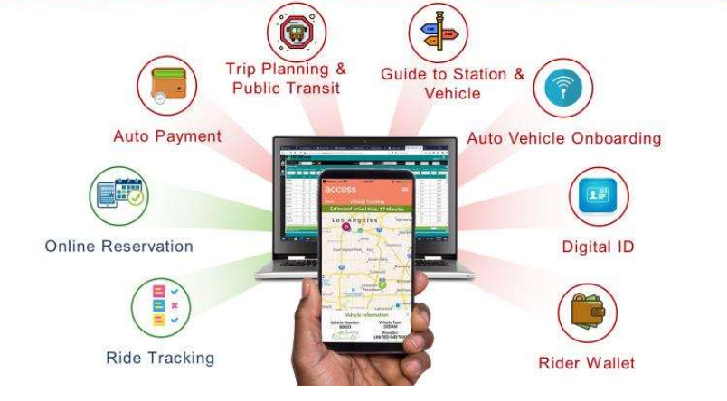
Accessible Traveler Mobil App
FTA Mobility for All Grants – Accessible Traveler Mobile App
Awarded $330,000 on June 5, 2020
18 month project began late June 2021
Major Function | Status | Estimated Completion
BLE Beacon | In Progress | June 2022
Mobile Ticket/Wallet | In Progress | Dec 2022
Trip Planner | In Progress | September 2022
Mobile Reservation | In Progress | October 2022

Slide 3
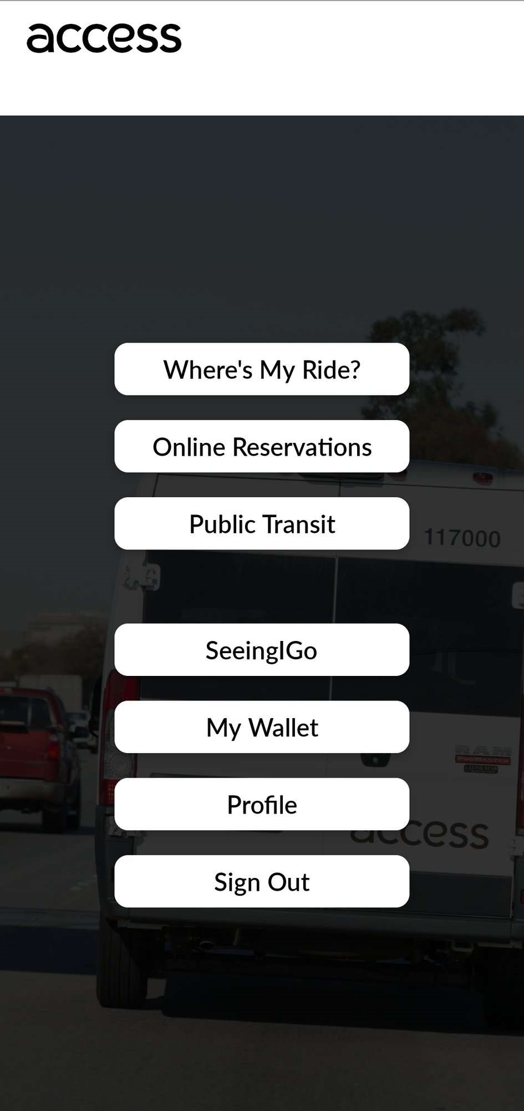
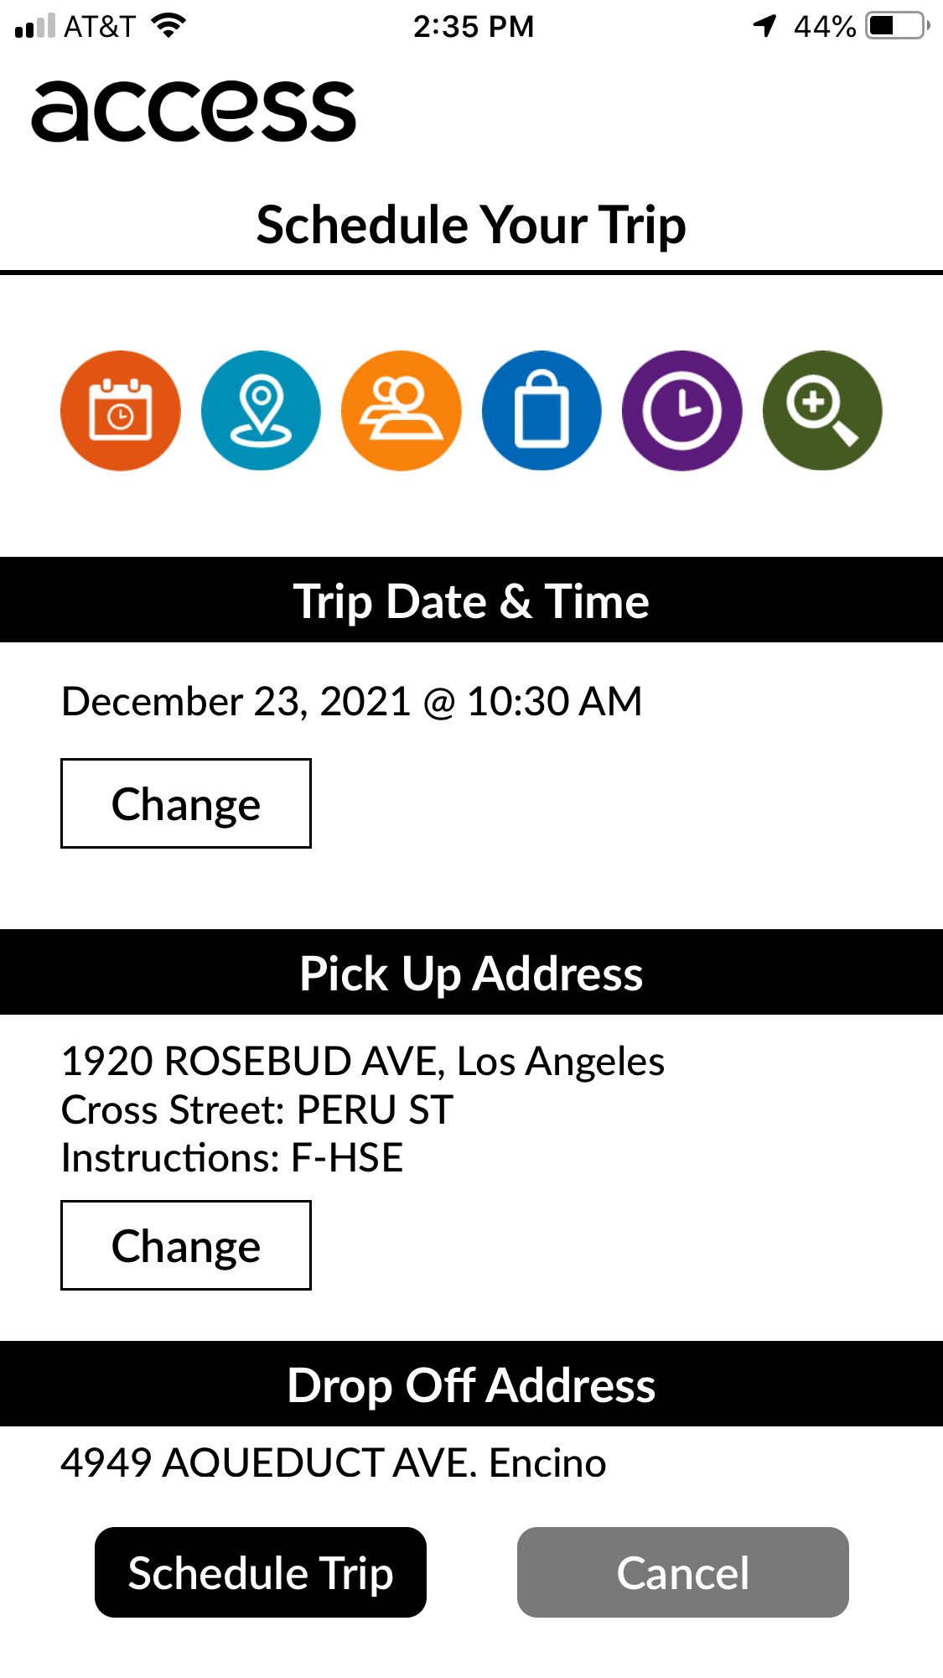
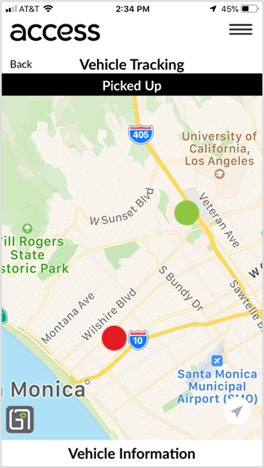
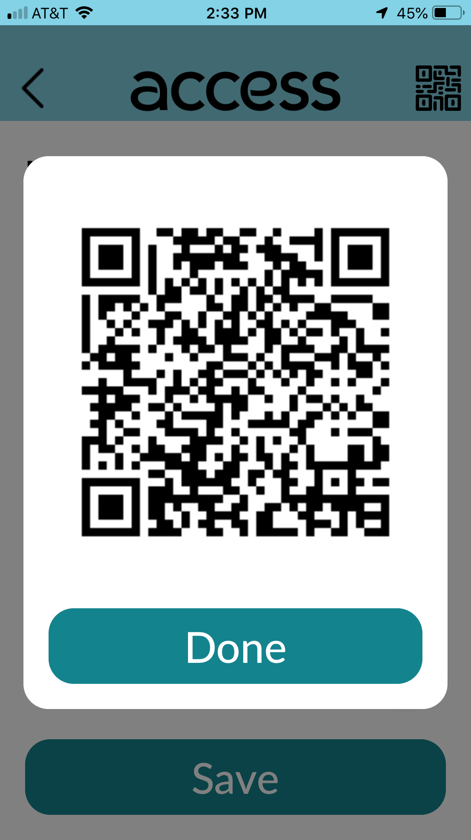
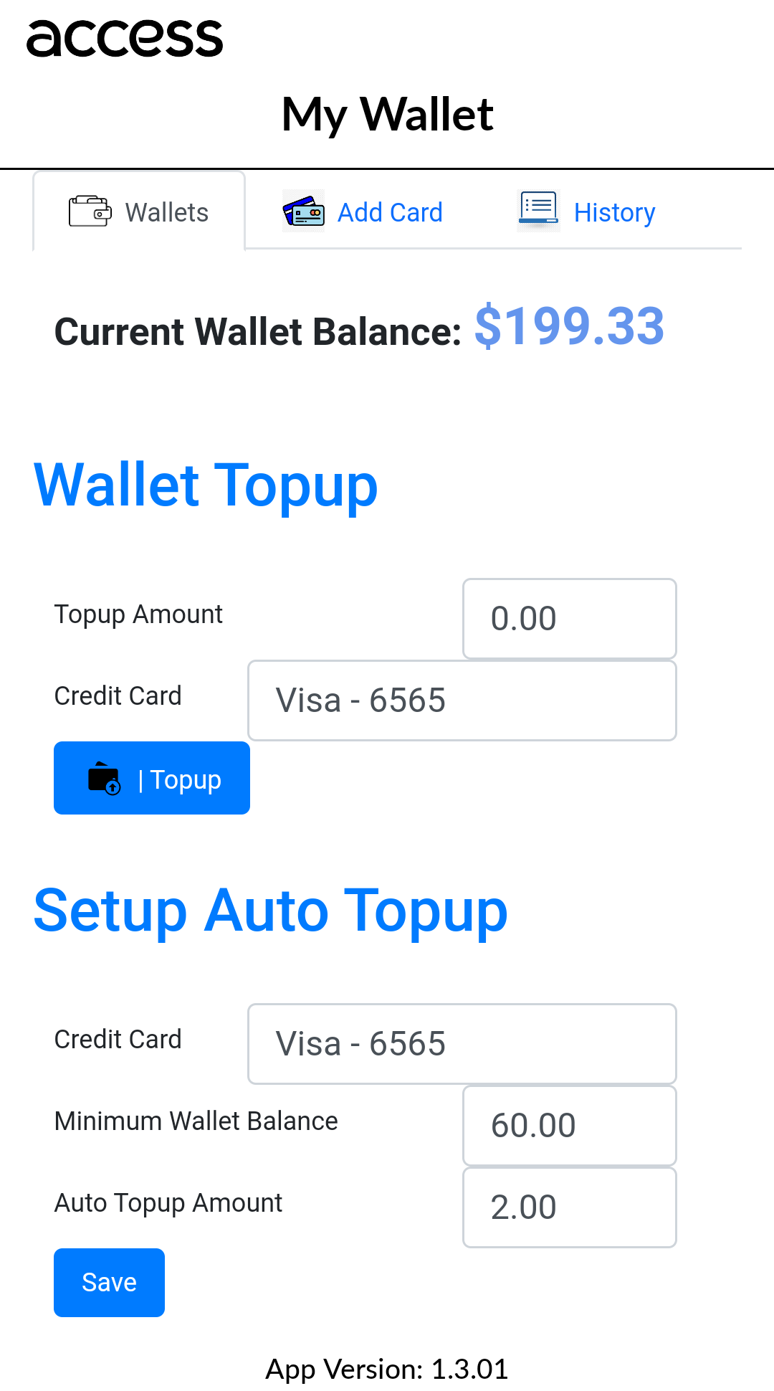
Accessible Traveler Mobil App

Slide 4
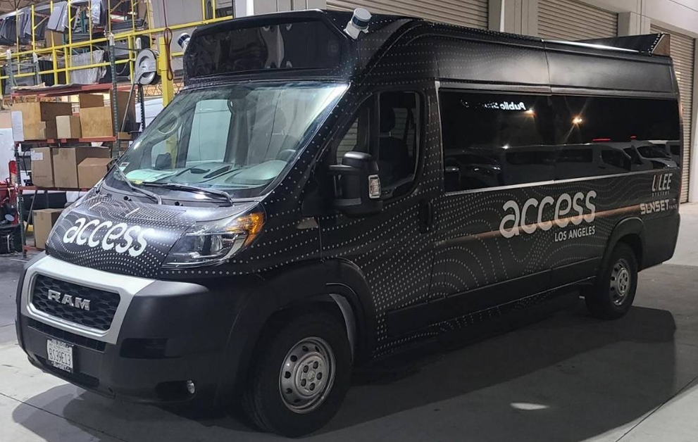
Accessible Autonomous Vehicle
FTA Transit Bus Automation Strategic Partnership – Accessible Autonomous Vehicle (AAV) Pilot
Awarded $125,000 on August 2, 2019
Task | Status | Estimated Completion
SoCal Regional Demo | Planning in progress | Late 2022/early 2023
RLA Demo | Planning in progress | 1st Qtr 2023

Slide 5
Trapeze Online Reservation
Trapeze Online Reservation – Northern and Santa Clarita Regions
Task | Status | Estimated Completion
Trapeze API Integration | Completed | June 2022
Beta Testing | Completed | October 2022
Focus Group Testing | In Progress | Late December 2022
Go-Live | To be starting | January 2023

Slide 6
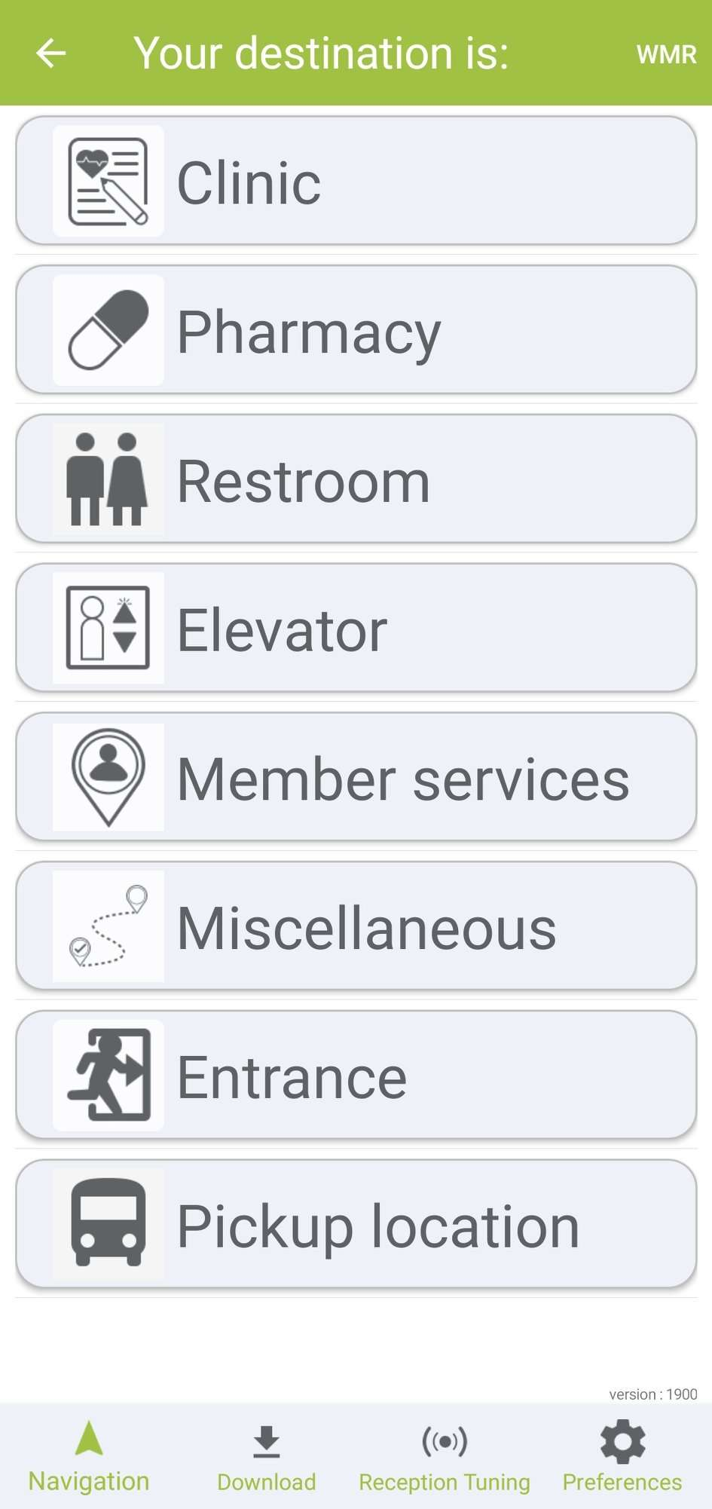
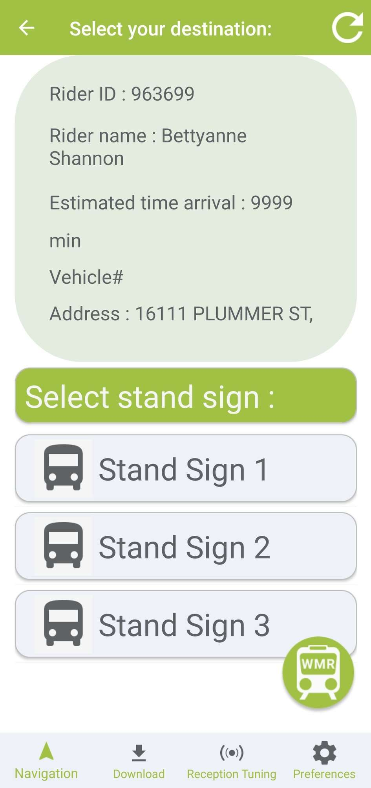
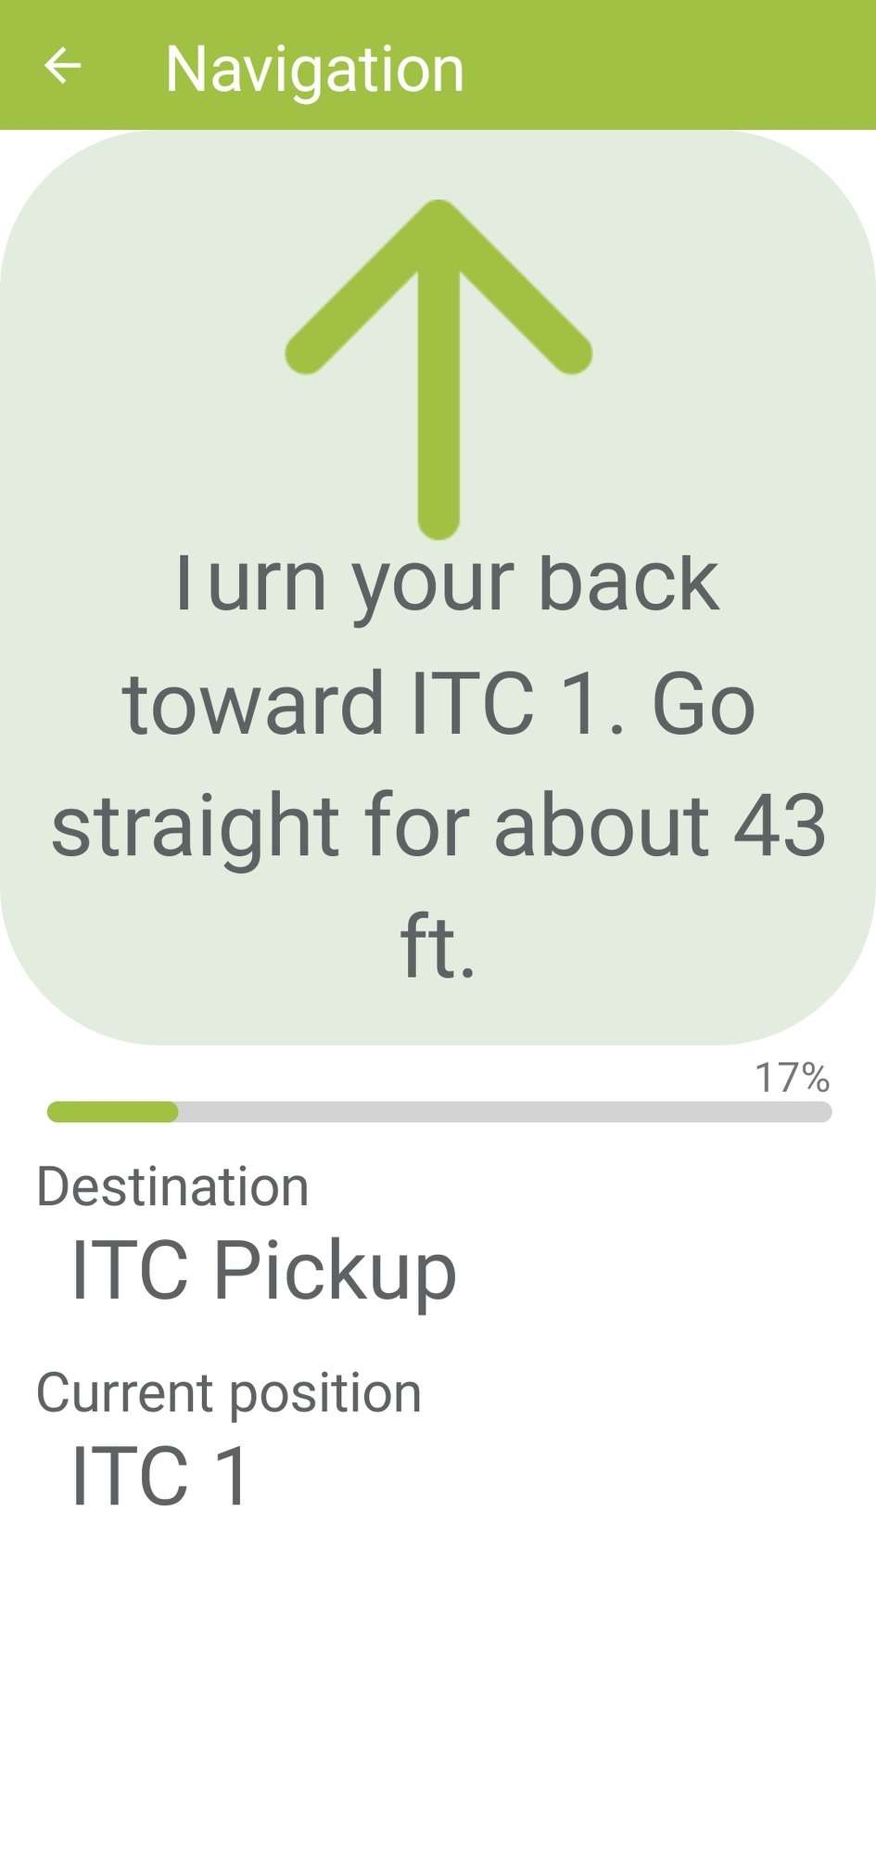
Bluetooth Wayside Demo

