Slide 1
Access Free Fare Program Assessment Survey
CAC Meeting
March 14, 2017

Slide 2
Methodology
Telephone survey
Sample Population
Rode on Bus or Train using Free Fare Program at least once in previous six months
Interview Dates
January 9 to 22, 2017
Sample Size
800
Questionnaire Length
18 minutes and 50 seconds
Sampling error
+ 3.5 percentage points

Slide 3
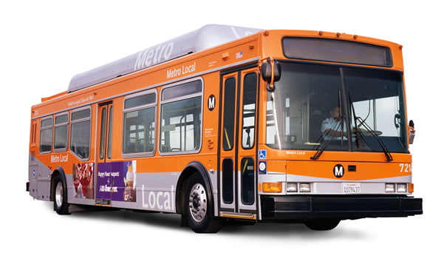
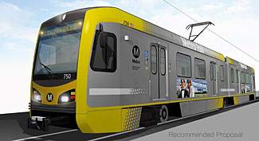
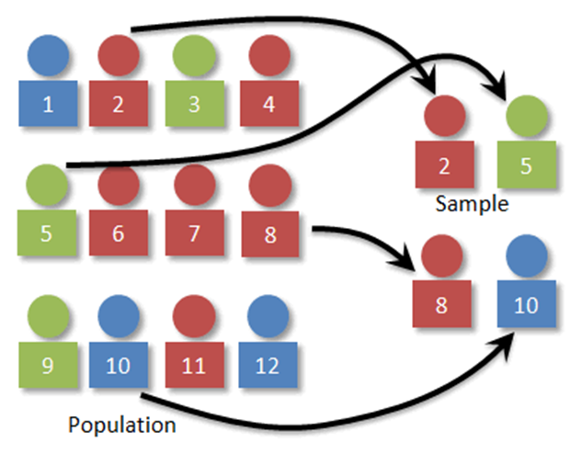
The Sampling Process
105,450
800

Slide 4
Monthly Ridership
Bus/Train Trips Per Month
Ride Bus/Train With PCA
Average Monthly Bus/Train Trips
n = 800

Slide 5
Use of Free Fare Card
How People Use Access ID Card
Okay To Let Other People Use Access ID Card Ride Bus/Train
n = 800

Slide 6
Bus/Train Trip Purposes
n = 300

Slide 7
Reason Ride Bus/Train
n = 800

Slide 8
Ridership Impact: Per-Trip/Monthly TAP Card Fee
n = 800

Slide 9
Preferred Change to Free Fare Program
(4 Trips per Day or 100 Trips per month)
n = 800

Slide 10
How Replace Bus/Train Trips (Customers Who Said They Would Take Fewer Trips on the Bus/Train)
 | Charge Fee | Monthly Card
Call Access and schedule a ride | 64% | 57%
Take fewer trips and stay home | 46% | 56%
Get a ride with a friend or family member | 48% | 52%
Use Uber or Lyft | 13% | 15%
Use a taxi | 11% | 9%
Walk | 4% | 6%
Ride bike/Skateboard | 1% | 1%
Pay Fee/Take Bus/Use Senior Discount Card | 2% | 0%
Drive Myself | 1% | 0%
Other | 4% | 3%
Don’t know/Not Sure | 3% | 3%
Base | 614 | 400

Slide 11
Questions

