Slide 1
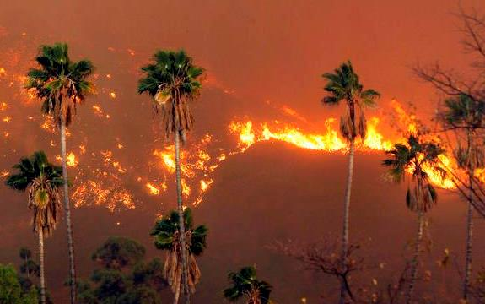
Extreme Conditions
Paratransit and Emergency Response

Slide 2
December 2011 – Pasadena, CA
Notes:
High winds snapped power lines and downed trees across the San Gabriel Valley; some streets were blocked for days

Slide 3
Colby Fire – San Gabriel Foothills – January 2014
Notes:
1,952 acres burned in the cities of Azusa and Glendora, east of DTLA

Slide 4
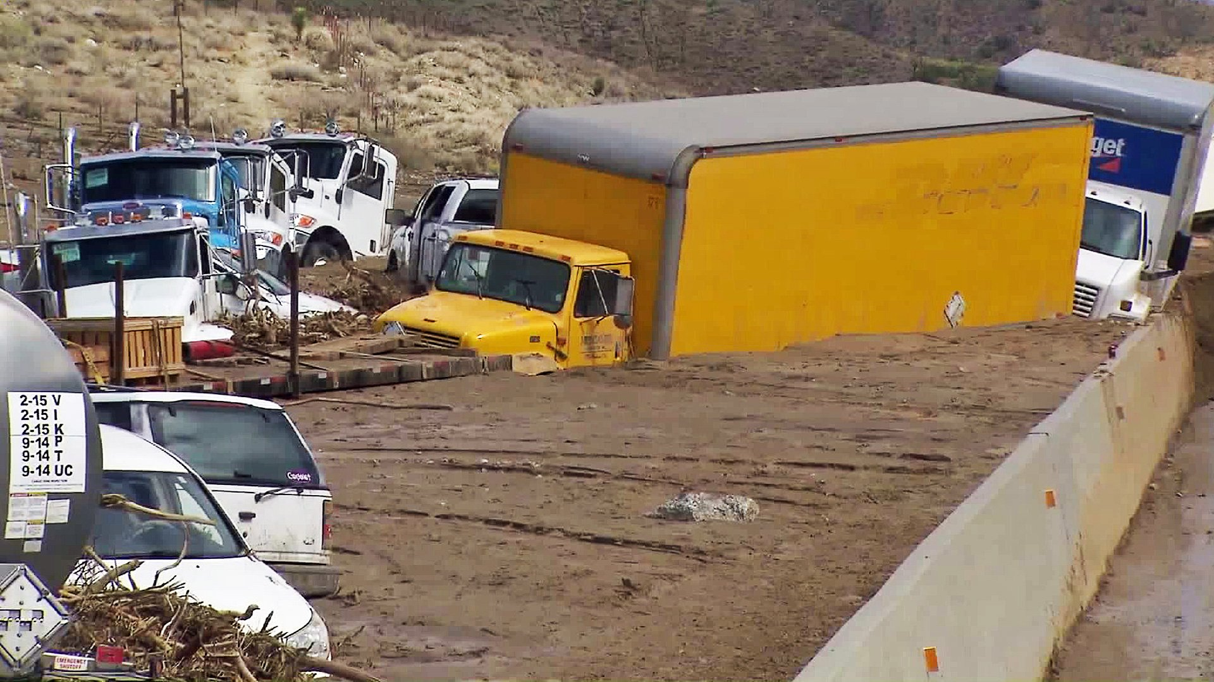
Mud Slides and Flooding – October 2015
Notes:
LA’s Antelope Valley region was inundated by rain and mudslides in October 15. Paratransit vehicles had to stage at a makeshift yard due to flooded streets.

Slide 5
El Niño Storms Threaten Los Angeles– late 2015
Notes:
Access developed a severe weather plan in anticipation of the infamous El Nino storms that never occurred.

Slide 6
Sand Fire – Santa Clarita, CA – July 2016
Notes:
41,432 acres burned in a mostly rural and uninhabited areas; but some neighborhoods were evacuated and transit was unable to run in selected areas

Slide 7
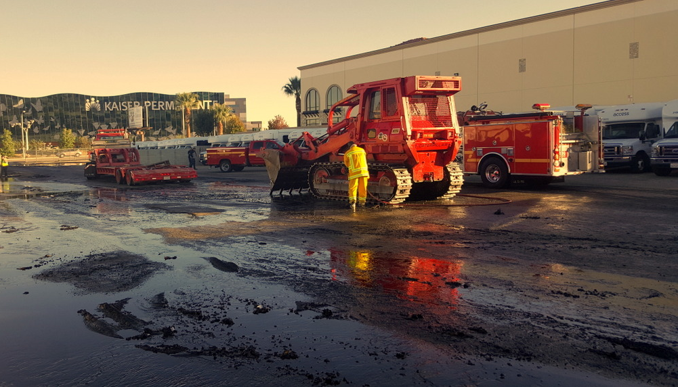
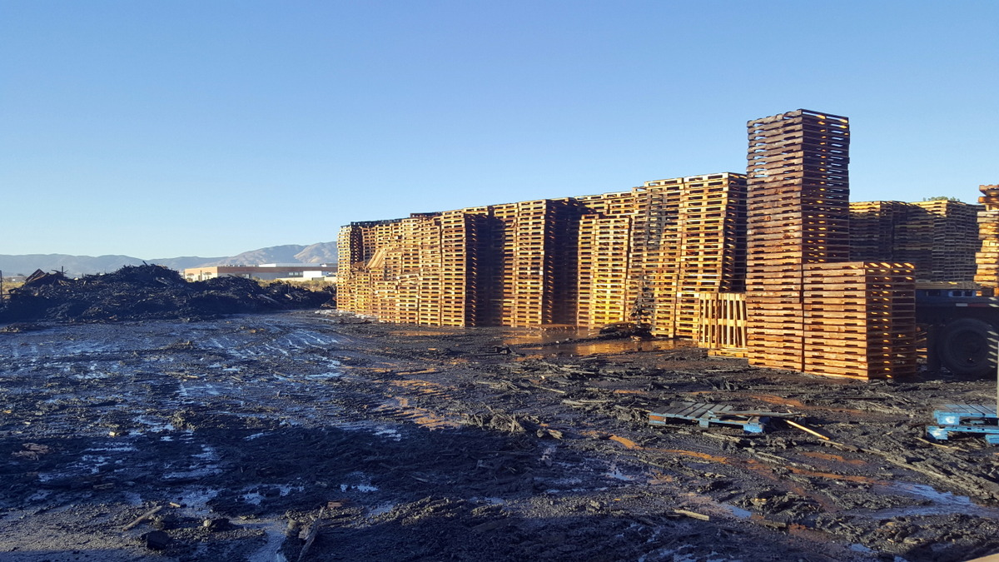
Yard Fire – Lancaster, CA – November 2016
Notes:
41,432 acres burned in a mostly rural and uninhabited areas; but some neighborhoods were evacuated and transit was unable to run in selected areas

Slide 8
Contract Ready
Service contracts include:
Emergency service provisions
Driver training requirements
Training requirements of key staff that comply with the National Incident Management System (NIMS) and Incident Command System (ICS)
ICS organization positions identified
Multiple layers of communication capabilities

Slide 9
Staff Preparation
3-deep ICS organization structure
All key staff ICS trained, with many having extensive training
Annual exercises/tabletop drills
External agency drills including LA Metro and LA County
Everbridge used to communicate with off-site staff and contractors

Slide 10
Driver Training
New driver training includes 2-4 hours of emergency preparedness/management
ICS terminology
Calling dispatch vs. calling 911
Emergency priorities
6 steps of crisis management
Personal preparedness

Slide 11
Lessons Learned
In the past three years, EOC activated for:
3 wildfires
1 yard fire
2 technology failures
Almost activated for:
El Niño
Civil unrest
Active shooter at UCLA

Slide 12
Lessons Learned
Every incident presents new challenges
Practice needed
Communication has been our biggest weakness
Everbridge software works well for communication and setting up conference calls

Slide 13
Lessons Learned
Bus yards need at least two entrances/exits
Paratransit systems with multiple contractors need back-up arrangements
Need access to rider trip info
IT needs to be actively involved in supporting operations
Keep staff contact information updated; need secondary contact method

Slide 14
Lessons Learned
Keep customer service in the loop as the emergency grows; they will be getting the calls
Send staff to contractors to act as liaison
If commuter rail (Metrolink) is not running, impact to our service is significant
Monitor weather on a daily basis

