Slide 1
Transfer Trip Expansion
Quality Service Subcommittee
February 21, 2019

Slide 2
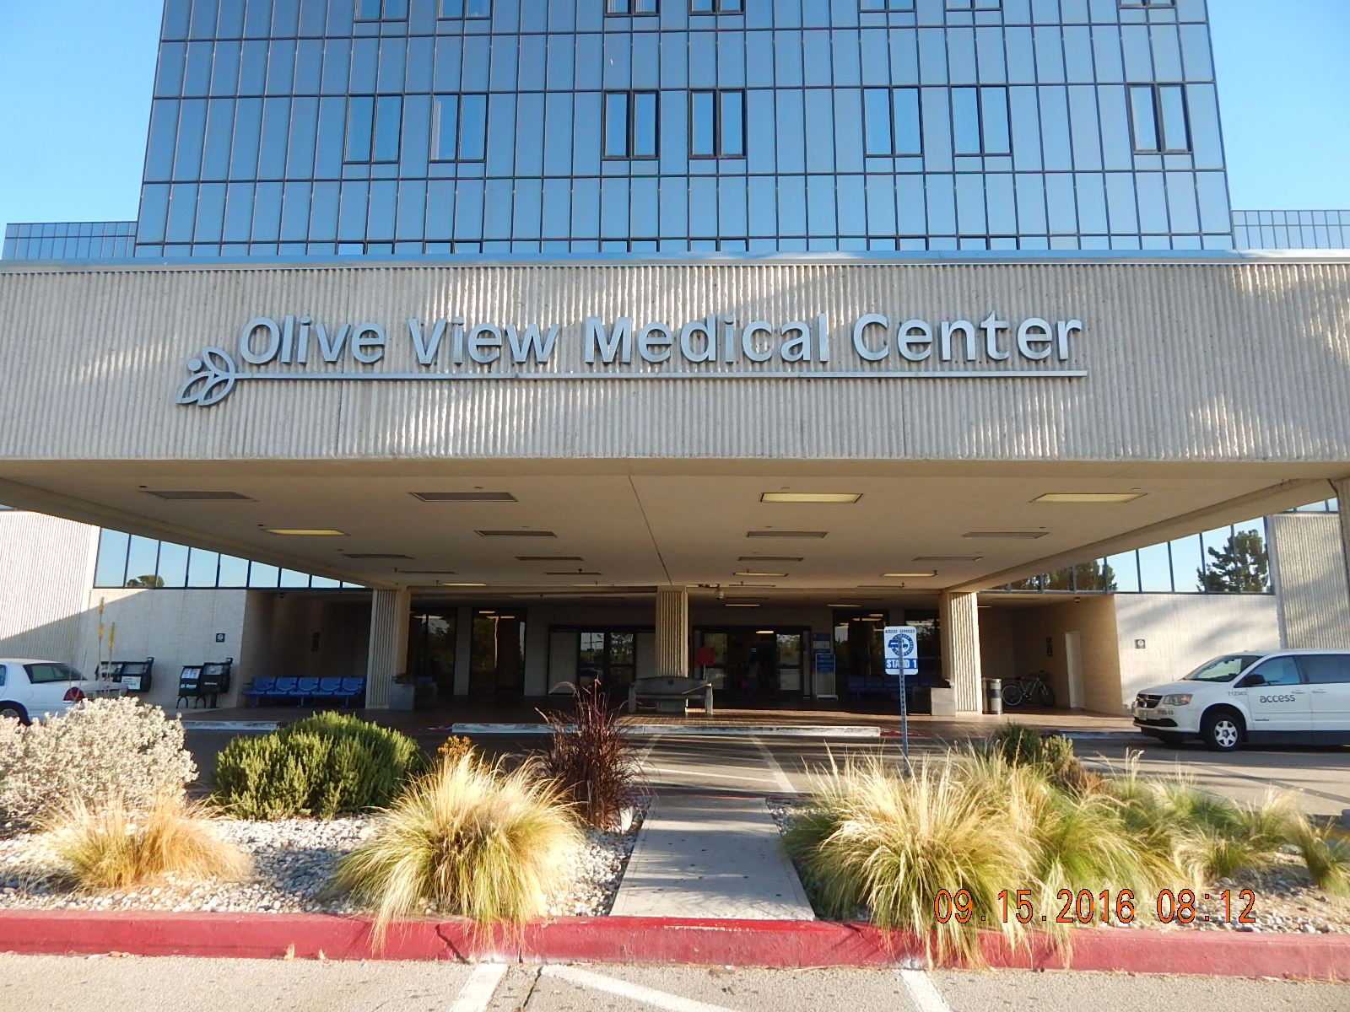
Current Status
Transfer connections between Antelope Valley, Santa Clarita and the Los Angeles Basin are available on weekdays only
Transfers occur at Olive View Medical Center in Sylmar

Slide 3
Current Status
Three connections per weekday to/from Antelope Valley
Four connections per weekday to/from Santa Clarita
Transfer trips cost $7.00 (AV to LA and AV to SC) and $6.00 (SC to LA)
Starter at Olive View Medical Center monitors trips and solves problems
One reservation call takes care of round trip scheduling

Slide 4
Current Usage - Week of January 28, 2019
REGION | BOOKED TRIPS
Antelope Valley | 159
San Fernando Valley | 127
Santa Clarita | 53
Southern | 25
West/Central | 22
Eastern | 19
TOTAL | 405

Slide 5
Outreach
CAC Meeting on December 11, 2018
Santa Clarita AAC meeting on January 3, 2019
Antelope Valley community meeting at ILC in Lancaster on January 18, 2019
Discussion with Keolis, Santa Clarita Transit, MV Transportation and other Access contractors
CAC Meeting on February 12, 2019
Notes:
AAC = Accessibility Advisory Committee

Slide 6
Outreach results
Rider feedback:
Eliminate transfers altogether; trip time too long
Add additional weekday connections
Schedule not conducive to work, school, or family
Add weekend and holiday connections
Use more comfortable vehicles
Fare is too high
Consider alternate locations for transfer connection

Slide 7
Schedule for Weekday Service*
CURRENT Antelope Valley SCHEDULE | CURRENT Santa Clarita SCHEDULE | PROPOSED SCHEDULE
- | - | 600am
730am | 730am | 730am
- | - | 1000am
100pm | 1230pm | 1230pm
- | 300pm | 300pm
- | - | 430pm
600pm | 530pm | 600pm
- | - | 800pm
*times due at Olive View Medical Center

Slide 8
Schedule for Weekend and Holiday Service*
CURRENT Antelope Valley SCHEDULE | CURRENT Santa Clarita SCHEDULE | PROPOSED SCHEDULE
- | - | 730am
- | - | 1230pm
- | - | 600pm
*times due at Olive View Medical Center
Service will not operate on holidays that fixed route service does not operate:
Antelope Valley - New Year’s Day, Memorial Day, Independence Day, Labor Day, Thanksgiving Day and Christmas Day
Santa Clarita – Thanksgiving Day and Christmas Day

Slide 9
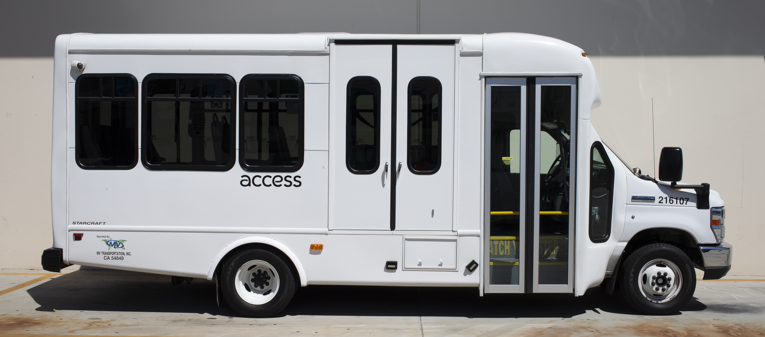
Other Improvements Planned
Upgraded suspension on large vehicles
Additional starter to be added to Olive View Medical Center to assist riders and drivers during expanded hours and days of service
Lower fare consistent with distance-based fare used in other parts of the county
0 to 19.9 miles = $2.75
20 or more miles = $3.50
Notes:
Upgraded suspension – liquid spring upgrade being made to three (3) vehicles being built for delivery this summer.

Slide 10
Next Steps
Finalize service changes including new schedule
Review by TPAC in March 2019
Identify resource needs
Address any contract issues
Develop outreach plan
Seek Board approval in March 2019 – proposed start date of July 1, 2019
Conduct evaluation of changes at six-month mark

