Slide 1
2018 Lone Star Promaster

Slide 2
2018 Lone Star Promaster
Notes:
3.6L V6 24V VVT Engine
6-Speed Automatic 62TE Transmission
GVW 9800 lbs. empty 7100 pay load of 2700 lbs.
Length 21 feet long 6.5 feet wide 8 foot tall interior 6.5 foot 13.25 foot wheel base

Slide 3
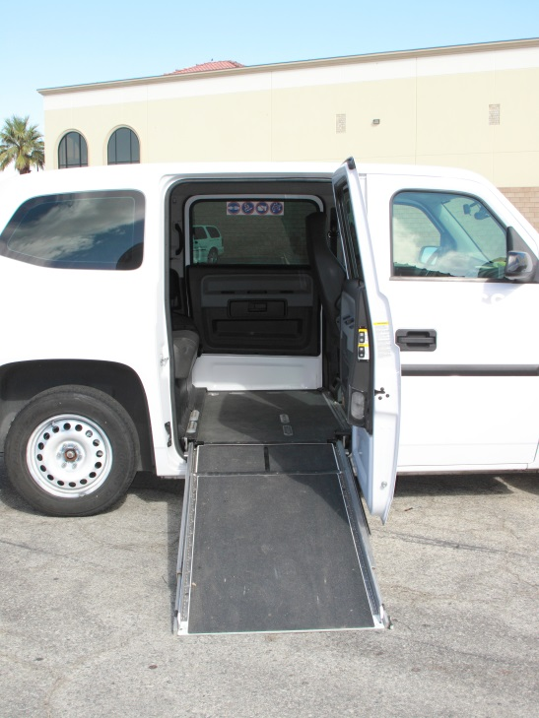
Access Mobility Ventures CNG MV1
3 Ambulatory 1 Mobility Aid
Purpose Built ADA CNG Fuel
15mpg CNG fuel $2.25gge
.13 mile maintenance
Access planned service life 4yr or 250,000 miles
$60,000 Purchase
$37,500 Fuel to 250
$32,500 Maintenance
$130,000 Life Cycle Cost
Notes:
No longer in production, this is an excellent vehicle qualifying for both ADA and Alt fuel grants. Access did plan on buying MV1s in the future and named the product in Federal and local grants. Access has 100 CNG and 33 Unleaded MV1s

Slide 4
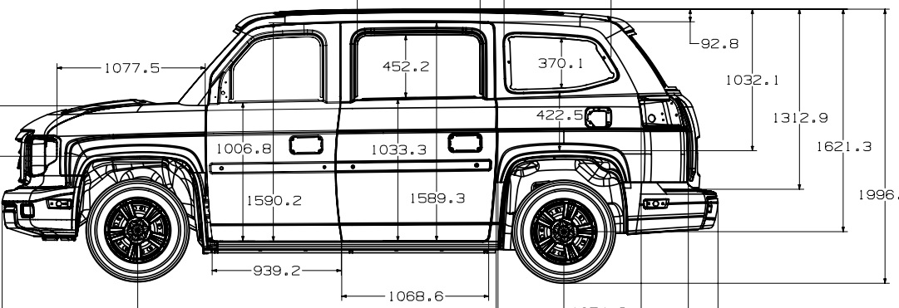
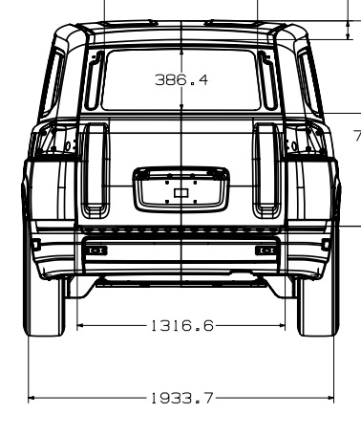
2014 CNG MV1
3 Ambulatory 1 Mobility Aid

Slide 5
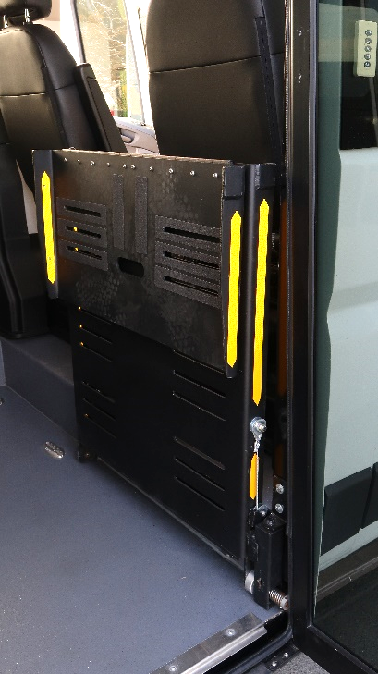
2018 Lone Star Promaster
5 Ambulatory 2 Mobility Aid
Access Spec CNG
Dodge Promaster Low Floor Ramp
12 mpg 2.25 CNG
.13 mile maintenance
Access planned service life
4yr or 250,000 miles
$120,000 Purchase
$46,875 Fuel to 250
$32,500 Maintenance
$199,375 Life Cycle Cost
Notes:
New design CARB certification will be completed as part of the Access contract. There will be purchase options available for smaller agencies to use on a case by case basis. Subject to approval by Access Procurement team.
4 to 5 ambulatory 2 mobility aids, Lowered floor with manual ramp (no lift needed).

Slide 6
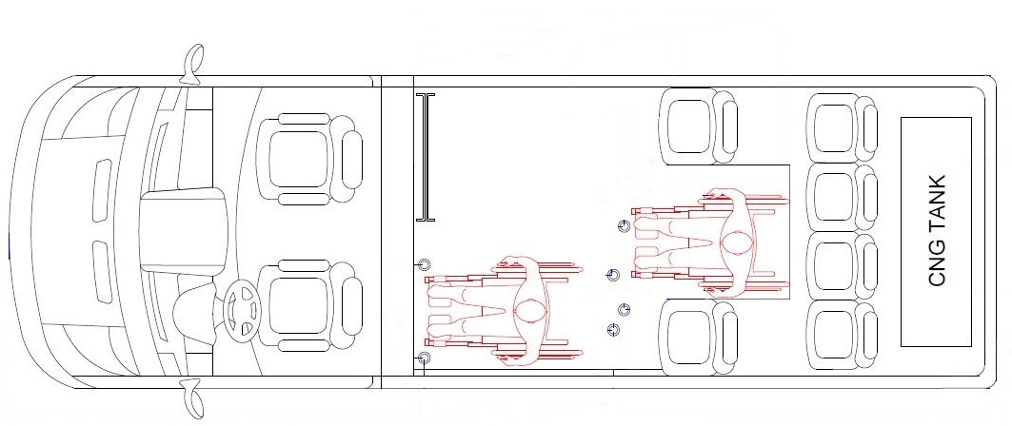
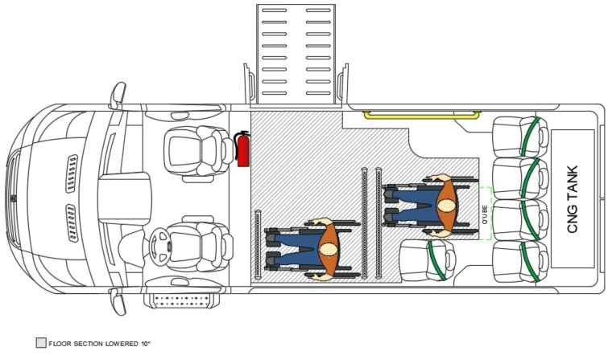
Notes:
Top diagram shows Pilot vehicle as delivered. For service we removed the street side single seat to allow better egress to the back of the vehicle.
Lower diagram shows the configuration that Access plans for service fleet, added grab rail going to back seats and pushed the 4 rear seats back as far a possible to allow more room for service animals.

Slide 7
2018 Lone Star Promaster
Notes:
Better view of production floor plan.

Slide 8
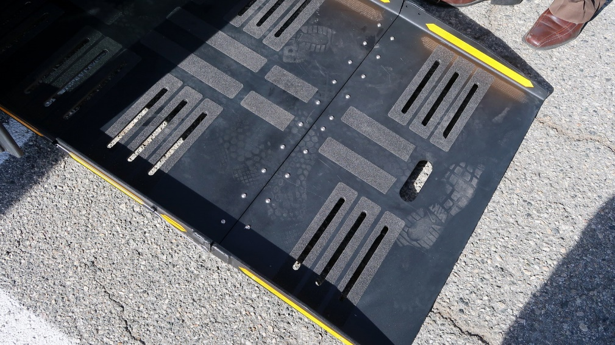
2018 Lone Star Promaster

Slide 9
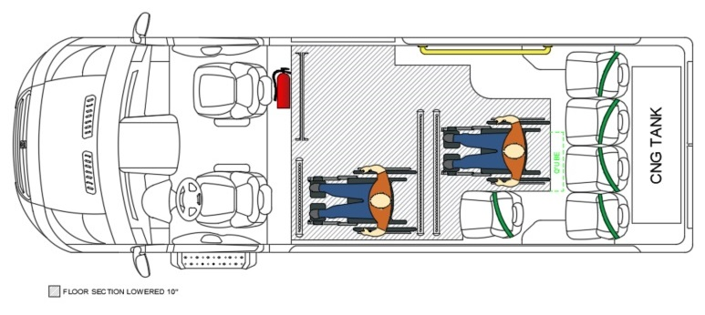
2018 Lone Star Promaster

Slide 10
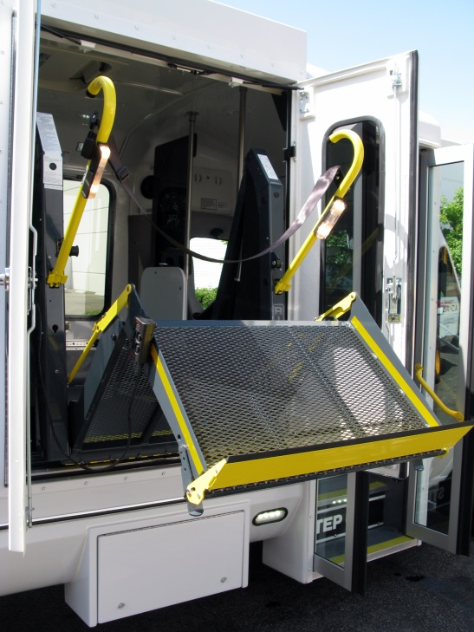
Access Eldorado Aerolite
7 Ambulatory 2 Mobility Aid
CalAct/MBTA Spec
Ford Narrow body flat floor cutaway
9mpg 3.95 Unleaded
.19 mile maintenance
Access planned service life
4yr or 250,000 miles
$65,000 Purchase
$109,723 Fuel to 250
$47,500 Maintenance
$222,223 Life Cycle Cost
Notes:
Access Fleet has 43 Class A Cutaways uses Ricon Lift has raised floor to help with mobility aid maneuvering and flip seating limited to 5 ambulatory when two mobility aids are on board

Slide 11
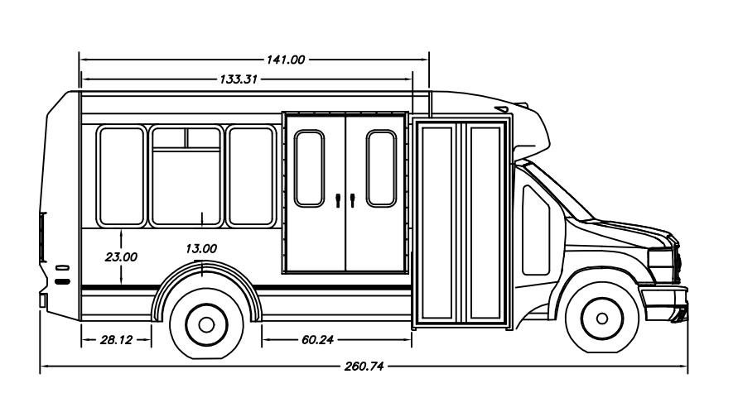
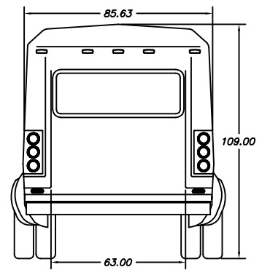
2014 Eldorado Aerolite
7 Ambulatory 2 Mobility Aid

Slide 12
Life Cycle Cost Comparison
 | CNG MV1 | Gas Class A | CNG Promaster
Capacity | 3A/1M | 5A/2M | 5A/2M
MPG | 15 | 9 | 12
Maintenance | 0.13 | 0.19 | 0.13
Expected Life | 4Y/250k | 4Y/250k | 4Y/250k
Purchase Price | $ 60,000 | $ 65,000 | $ 120,000
Fuel to 250k | $ 37,500 | $ 109,723 | $ 46,875
Life Cycle Cost | $ 130,000 | $ 222,223 | $ 199,375
Notes:
While the MV1 is clearly a cheaper alternative, the vehicle is no longer in production and there are no current plans to revive that vehicle. In addition, the MV1 has some limitations – mainly that it only has capacity for a single mobility device.

