Slide 1

Autonomous Vehicle Pilot Project
William Tsuei
Director of Information Technology

Slide 2
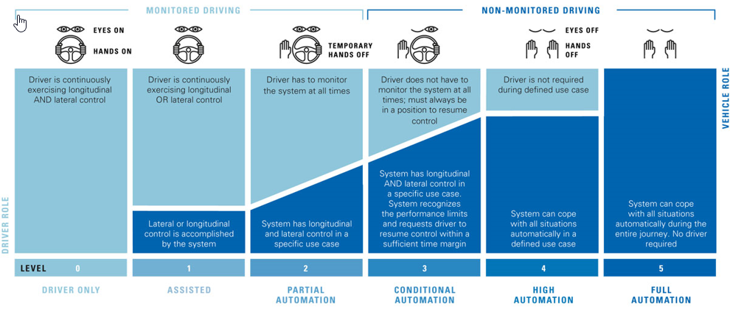
Autonomous Vehicle 101

Slide 3
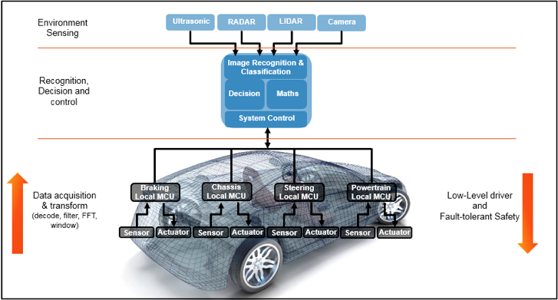
Autonomous Vehicle 101

Slide 4
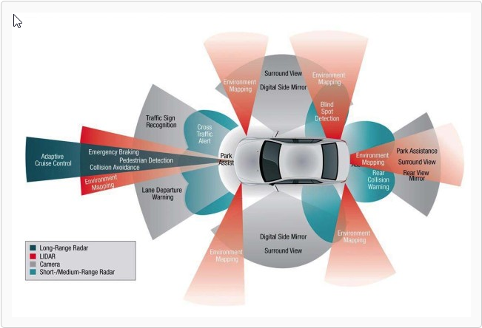
Autonomous Vehicle 101

Slide 5
Autonomous Vehicle Pilot Update
Long Term Goals:
Overcome driver shortages
Improve services quality
Understand operational impacts
Prepare for workforce changes
Reduce operating costs
Embrace new technologies for people with disability

Slide 6
Autonomous Vehicle Pilot Project
Route Analysis: 4 routes have been identified to go through the analysis based on paratransit ridership and existing bus routes data
Ridership Data Analysis (Jan 2017 to Dec 2017)
 | VA Greater Los Angeles Healthcare Center | VA Long Beach Healthcare System | Lancaster Station | Rancho Los Amigos
Total trips to here | 13788 | 4665 | 2665 | 17690
Number of customers | 1122 | 479 | 287 | 1597
Use free fare TAPs>10 times | 453 | 133 | 147 | 629
Mobility device | 295/1122 | 137/479 | 46/287 | 910/1597

Slide 7
Autonomous Vehicle Pilot Project
Route Analysis: 4 routes have been identified to go through the analysis based on paratransit ridership and existing bus routes data
Existing Bus Routes Data Analysis
 | VA Greater Los Angeles Healthcare Center | VA Long Beach Healthcare System | Between Lancaster station to senior center | Rancho Los Amigos
Bus route | 17 (Big Blue Bus) | 91/92/93/94 (LA Metro) | 250/100 (Kern Transit) | 117 (LA Metro)
Walk distance | 210 ft | 0.5-0.6 mile | 0.1 mile | 0.1mile
Times for trip | 15 min | 35 min | 5min-8min | 40min
Frequency | Every 20 min | Every 10min to 25min | Every 2 hours-3 hours | Every 20min

Slide 8
Autonomous Vehicle Pilot Project
Route Analysis: 4 routes have been identified to go through the analysis based on paratransit ridership and existing bus routes data
Existing Bus Routes Data Analysis
 | VA Greater Los Angeles Healthcare Center | VA Long Beach Healthcare System | Lancaster circulator route | Rancho Los Amigos
Total length | 2.93 miles | 4.2 /4.6 miles | 6.7 miles | 2.2 miles
Estimate running time | 15 min | 20 min | 30 min | 10 min
Speed limit | 20/30/35 mph | 20/30/40 mph | 25/35/40/45 mph | 25/35/40 mph
Zoning | Commercial use Residential use Industrial use | Planned development district | Mixed use neighborhood Residential | Residential use Commercial use

Slide 9
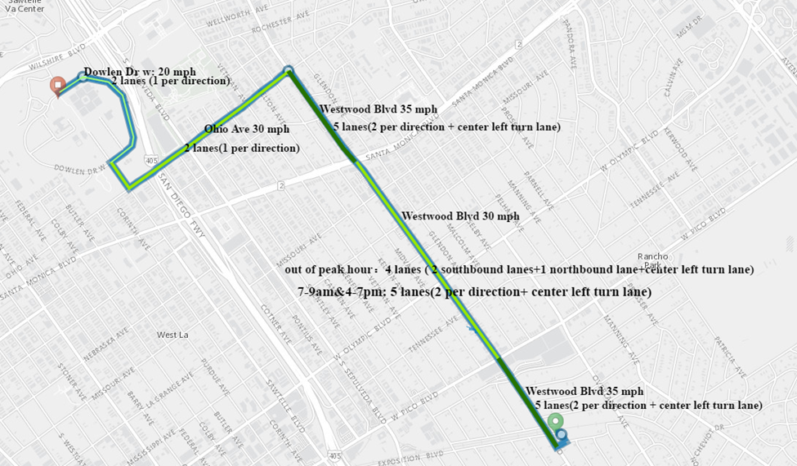
Autonomous Vehicle Pilot Project
Final Route Selection
Based on the data analysis, Access Services has identified VA Greater Los Angeles Healthcare Center as the route for AV pilot project.

Slide 10
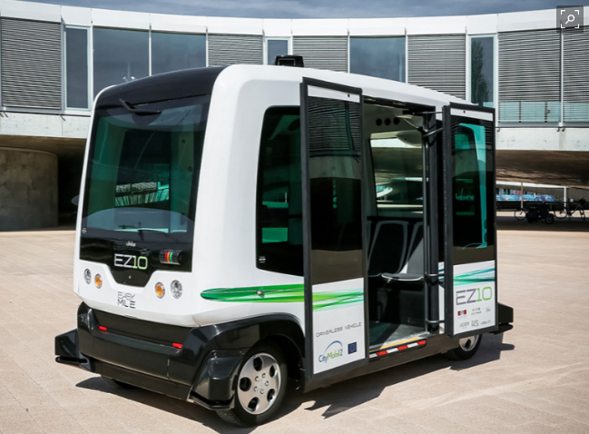
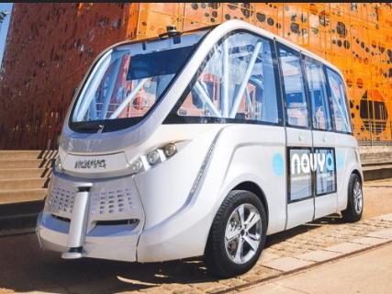
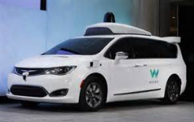
AV Comparison
Vehicle Key Performance
 | EZ 10 | Navya ARMA | Waymo minivan Chrysler Pacifica hybrid minivan
Capacity | 6 seating + 6 standing | 11 seating+ 4 standing | 7 seats (maximum)
Speed (cruising/maximum) | 13 mph/25mph | 15 mph/ 28 mph | Regular
L x W x H: | 154.6 x 78.35 x 84.65 | 187.0x 83.1x104.3 | 203.8 x 79.6 x 69.9 in
Engine/ Energy | Electric, battery pack LiFep04 | Electric, 15 kW/ battery pack LiFep04 (33 kW.h) | 3.6L DOHC 24-valve V-6 plus electric motor/260 hp combined
Fully charged mileage | Up to 150 mile | Up to 150 mile | 33 miles (electricity alone)

Slide 11
Project Partners
MOU in Place:
Lilee Systems
Baidu USA
Potential Partners:
US DOT/FTA
City of Los Angeles
LA County DOT
Westwood VA Hospital
LA Metro
Waymo
Ford Motor Co.
NAVYA
Cisco
MV Transportation
Keolis America
Intel/Mobileye
T-Mobile USA

Slide 12
Preliminary Project Timelines
Project Preparation: Current – October 2018
Vehicles Testing: July 2018 – December 2018
Non Revenue Services: January 2019 – March 2019
Circulator Services: April 2019 – October 2019
On Demand Services: November 2019 – June 2020

Slide 13
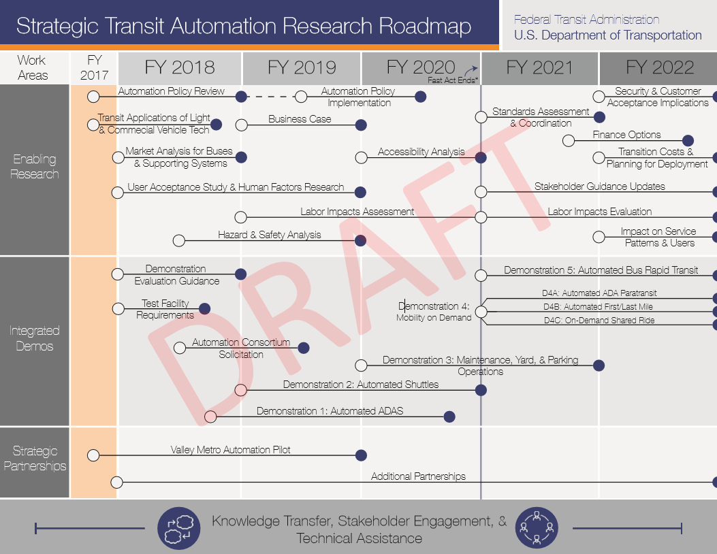
FTA Strategic Transit Automation Research Plan (STAR)

