Slide 1
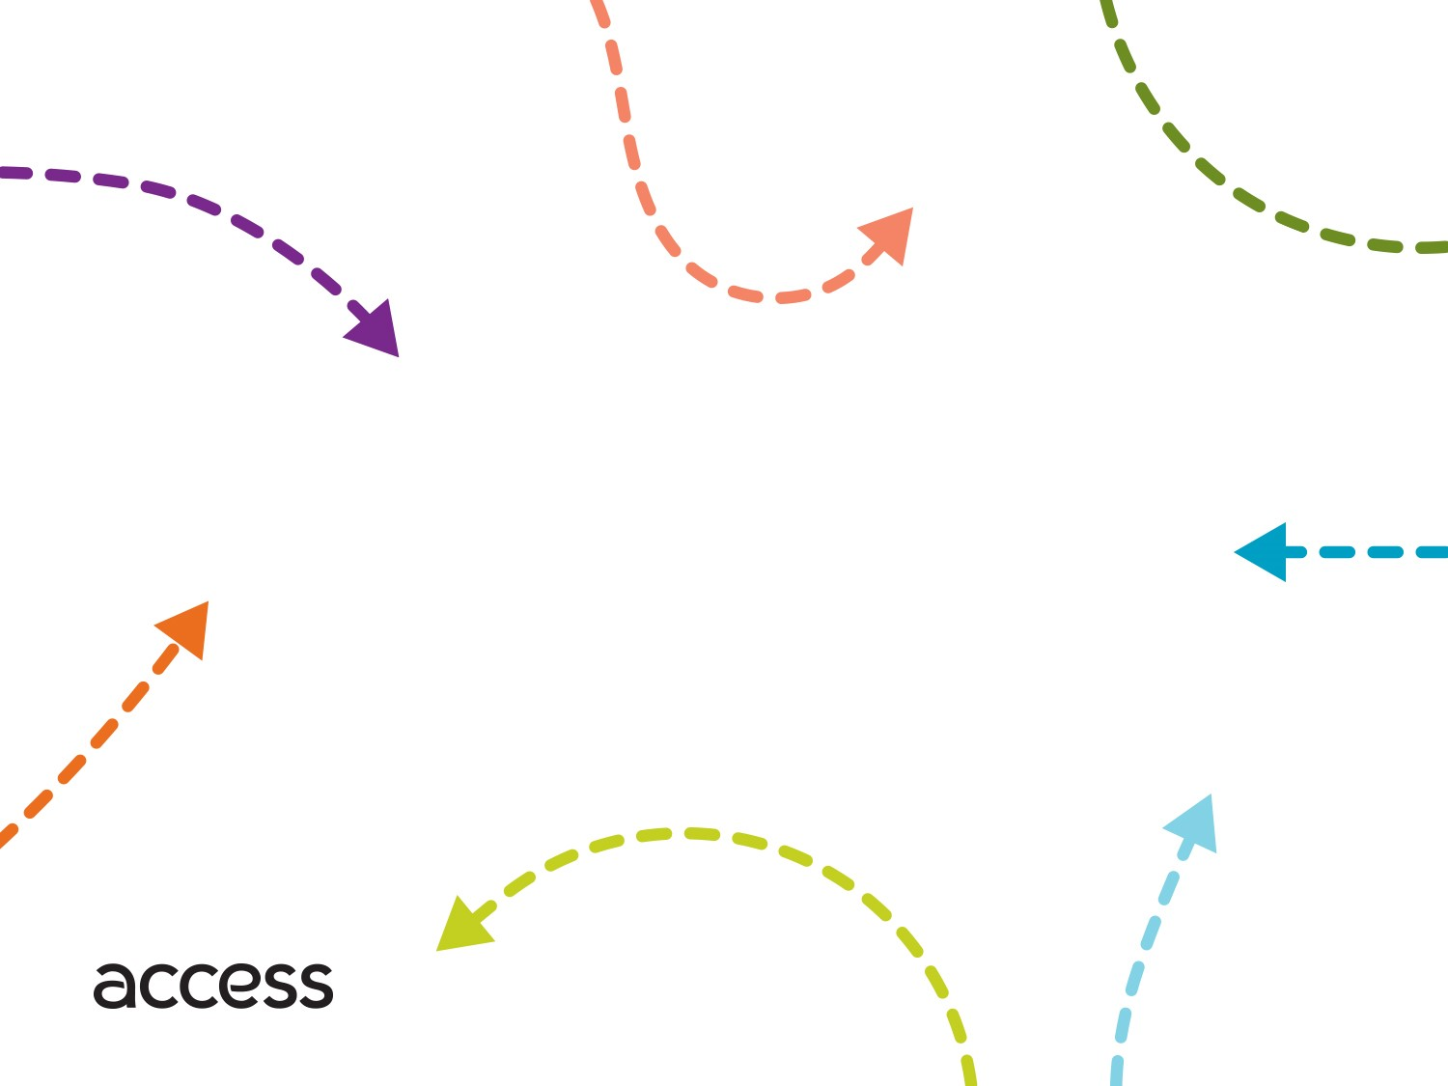
TPAC
Brokerage
Transportation Services

Slide 2
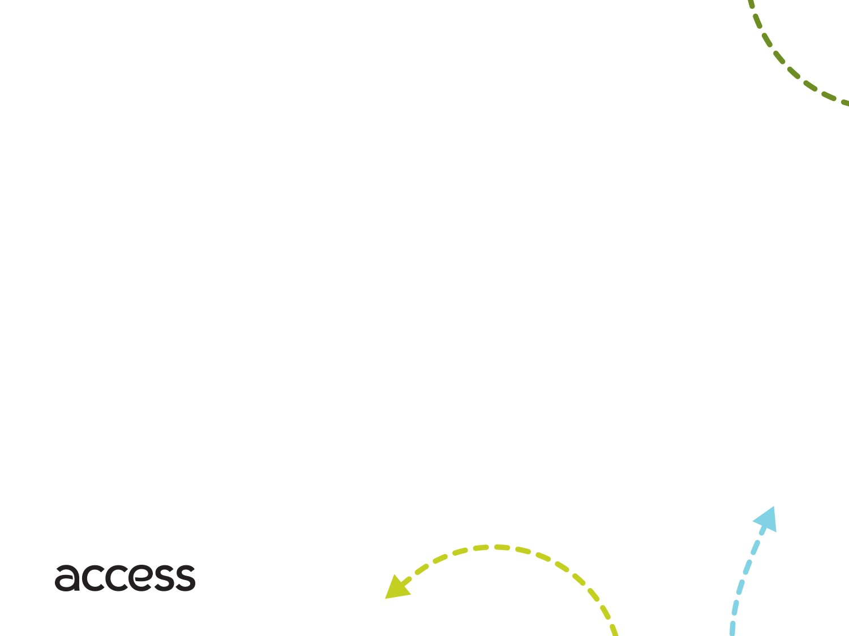
Transportation Brokerage
Arrange and monitor transportation services for individuals
Subcontracts with an established network of providers
Non-Emergency Medical Transportation (NEMT)
Taxis
Transportation Network Companies (TNCs - Uber, Lyft)
Ensures adequate resources are available
Matches client need with lowest cost, most appropriate resource
Creates competition between transportation companies to ensure best cost solutions
Ensures regulatory compliance (local, state, federal, etc.)
Notes:
The Strategic Plan aims to lay out the agency’s goals for the next five years
Beginning in FY 2019 through 2023
By being transparent with the Board and other stakeholders, we hope the process to be collaborative process.

Slide 3
Access
Brokerage
Reservations & Scheduling
Regulatory & Contract Compliance
Billing & Audit
NEMT
TNC
NEMT
Taxi
NEMT
NEMT
TNC
Notes:
The Strategic Plan aims to lay out the agency’s goals for the next five years
Beginning in FY 2019 through 2023
By being transparent with the Board and other stakeholders, we hope the process to be collaborative process.

Slide 4
Options
Eligibility Interview Transportation
Free transportation to/from eligibility interviews in Commerce
Fixed fleet size, 220 trips/day
Trips grouped geographically (i.e. Southern region on T&Th) and kept together to/from Commerce
Seldom opportunity to modify schedule on day of service
Parents with Disabilities
Limited as needed services
Notes:
The Strategic Plan aims to lay out the agency’s goals for the next five years
Beginning in FY 2019 through 2023
By being transparent with the Board and other stakeholders, we hope the process to be collaborative process.

Slide 5
Key scope topics
Broker call center operations would not be required to be within service area
Broker would not have to directly operate vehicles
Broker would not be tasked with emergency operations
Subcontractors would need to meet existing Access background, training and Drug and Alcohol testing requirements
Subcontractors would not be required to have in-vehicle recording
TNCs would be utilized in limited situations
Notes:
The Strategic Plan aims to lay out the agency’s goals for the next five years
Beginning in FY 2019 through 2023
By being transparent with the Board and other stakeholders, we hope the process to be collaborative process.

Slide 6
Questions
Notes:
The Strategic Plan aims to lay out the agency’s goals for the next five years
Beginning in FY 2019 through 2023
By being transparent with the Board and other stakeholders, we hope the process to be collaborative process.

