Slide 1
Access Free Fare Program Assessment Survey

Slide 2
Methodology
Telephone survey
Sample Population
Rode on Bus or Train using Free Fare Program at least once in previous six months
Interview Dates
January 9 to 22, 2017
Sample Size
800
Questionnaire Length
18 minutes and 50 seconds
Sampling error
+ 3.5 percentage points

Slide 3
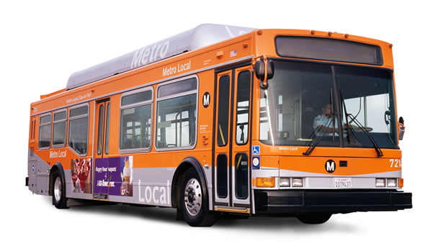
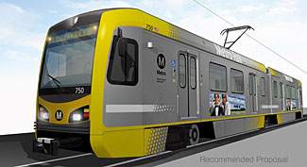
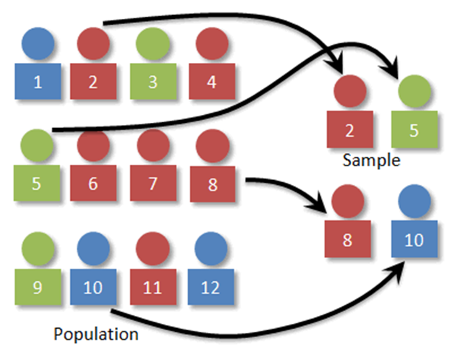
The Sampling Process
105,103
800

Slide 4
Monthly Ridership
Bus/Train Trips Per Month
Ride Bus/Train With PCA
Average Monthly Bus/Train Trips
n = 800

Slide 5
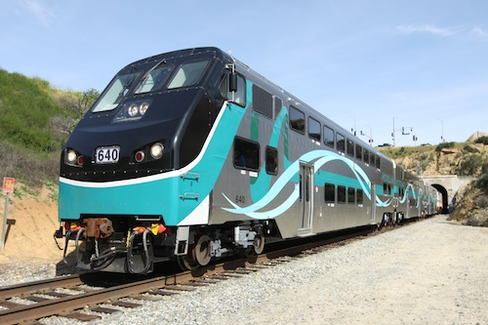
Metrolink Free Fare Monthly Ridership
Ride Metrolink with Access ID Card
Monthly Metrolink Free Fare Trips
Average Monthly Trips
12
n = 240

Slide 6
Use of Free Fare Program
How People Use Access ID Card
Okay To Let Other People Use Access ID Card Ride Bus/Train
n = 800

Slide 7
Bus/Train Trip Purposes
n = 300

Slide 8
Reason Ride Bus/Train
n = 800

Slide 9
Preferred Change to Free Fare Program
(4 Trips per Day or 100 Trips per month)
n = 800

Slide 10
Trip Limits
Limit Prefer: 100 Month or 4 Day
n = 800
Notes:
New Slide

Slide 11
Ridership Impact: Per-Trip/Monthly TAP Card Fee
n = 800

Slide 12
Potential Decrease Bus/Train Trips Per Month: Per-Trip Fee/Monthly TAP Card
n = 800
Notes:
New Slide

Slide 13
How Replace Bus/Train Trips (Customers Who Said They Would Take Fewer Trips on the Bus/Train)
 | Charge Fee | Monthly Card
Call Access and schedule a ride | 64% | 57%
Take fewer trips and stay home | 46% | 56%
Get a ride with a friend or family member | 48% | 52%
Use Uber or Lyft | 13% | 15%
Use a taxi | 11% | 9%
Walk | 4% | 6%
Pay Fee/Take Bus/Use Senior Discount Card | 2% | 0%
Other | 6% | 4%
Don’t know/Not Sure | 3% | 3%
Base | 614 | 400

Slide 14
Potential for Rides Switching to Access Per Month
 | Would Call Access: Avg. Trips Switch Per Month |  | Total Potential Trips Switch to Access Per Month |  | Annual Cost Assuming 10% of Trips Switch to Access at $25.00 Per Trip
 | Low | High | Low | High | Low $ | High $
$0.25 per trip | 2.3 | 4.2 | 117,847 | 215,198 | $3.5M | $6.4M
$0.50 per trip | 3.7 | 6.6 | 189,580 | 338,169 | $5.6M | $10.1M
$0.75 per trip | 4.7 | 8.5 | 240,817 | 435,521 | $7.2M | $13.0M
$1.00 per trip | 5.5 | 9.7 | 281,807 | 497,006 | $8.4M | $14.9M
Monthly Tap Card | 1.8 | 3.0 | 53,918 | 89,863 | $1.6M | $2.6M

Slide 15
Questions

