Slide 1
Item 8 -
On-Line Eligibility Applications

Slide 2
Eligibility Application Process
Applicants need to apply for an Access ID number prior to receiving application by –
Calling Customer Service or
Use on-line portal (21% of IDs are generated on-line)
Application is mailed to applicant who must fill it out and return it.
Application is reviewed and notation is made to allow the scheduling of evaluation.
Applicants are advised to wait seven days before scheduling evaluation.
Notes:
Applicable federal regulations as interpreted by the courts require that all public fixed route operators must provide or certify there is provided ADA paratransit service complementary to its fixed route and which is designed, funded and implemented to fully meet all projected demand for next-day complementary ADA service. [49 C.F.R. 37.131(b)] The paratransit system must also be operated so as to be free of capacity constraints . [49 C.F.R.37.131(f)] Anderson v. Rochester-Genesee Regional Transp. Authority 337 F.3d 201, 210 -212 (C.A.2 (N.Y.),2003)
The assurances in Group 01.F are consistent with the U.S. OMB assurances required in the U.S. OMB SF-424B and SF-424D
1. Administrative Activities. On behalf of your Applicant, you assure that:
a. For every Project described in any application it submits, it has adequate
resources to properly plan, manage, and complete its Project, including the:
(1) Legal authority to apply for Federal funding,
(2) Institutional capability,
(3) Managerial capability, and
(4) Financial capability (including funds sufficient to pay the non-Federal share
of Project cost),

Slide 3
Eligibility Application Process - expanded
Applicants can complete entire application on-line
Once Access ID is generated, applicant can choose to continue and fill out application or have it mailed to them.
Applicants can stop and return to the application at any time.
Once submitted, applicants need to wait only 1-3 days to schedule evaluation.
Notes:
Applicable federal regulations as interpreted by the courts require that all public fixed route operators must provide or certify there is provided ADA paratransit service complementary to its fixed route and which is designed, funded and implemented to fully meet all projected demand for next-day complementary ADA service. [49 C.F.R. 37.131(b)] The paratransit system must also be operated so as to be free of capacity constraints . [49 C.F.R.37.131(f)] Anderson v. Rochester-Genesee Regional Transp. Authority 337 F.3d 201, 210 -212 (C.A.2 (N.Y.),2003)
The assurances in Group 01.F are consistent with the U.S. OMB assurances required in the U.S. OMB SF-424B and SF-424D
1. Administrative Activities. On behalf of your Applicant, you assure that:
a. For every Project described in any application it submits, it has adequate
resources to properly plan, manage, and complete its Project, including the:
(1) Legal authority to apply for Federal funding,
(2) Institutional capability,
(3) Managerial capability, and
(4) Financial capability (including funds sufficient to pay the non-Federal share
of Project cost),

Slide 4
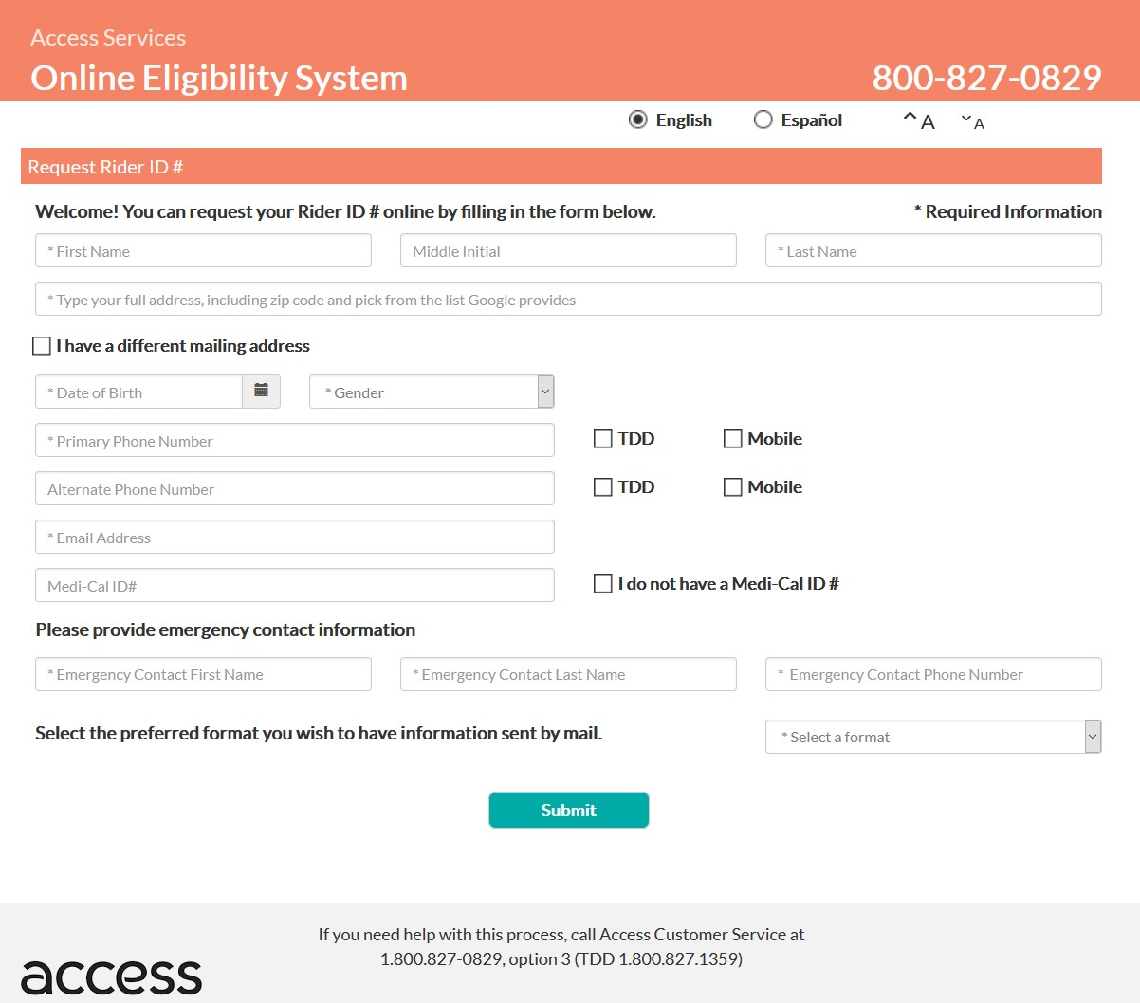
Notes:
Applicable federal regulations as interpreted by the courts require that all public fixed route operators must provide or certify there is provided ADA paratransit service complementary to its fixed route and which is designed, funded and implemented to fully meet all projected demand for next-day complementary ADA service. [49 C.F.R. 37.131(b)] The paratransit system must also be operated so as to be free of capacity constraints . [49 C.F.R.37.131(f)] Anderson v. Rochester-Genesee Regional Transp. Authority 337 F.3d 201, 210 -212 (C.A.2 (N.Y.),2003)
The assurances in Group 01.F are consistent with the U.S. OMB assurances required in the U.S. OMB SF-424B and SF-424D
1. Administrative Activities. On behalf of your Applicant, you assure that:
a. For every Project described in any application it submits, it has adequate
resources to properly plan, manage, and complete its Project, including the:
(1) Legal authority to apply for Federal funding,
(2) Institutional capability,
(3) Managerial capability, and
(4) Financial capability (including funds sufficient to pay the non-Federal share
of Project cost),

Slide 5
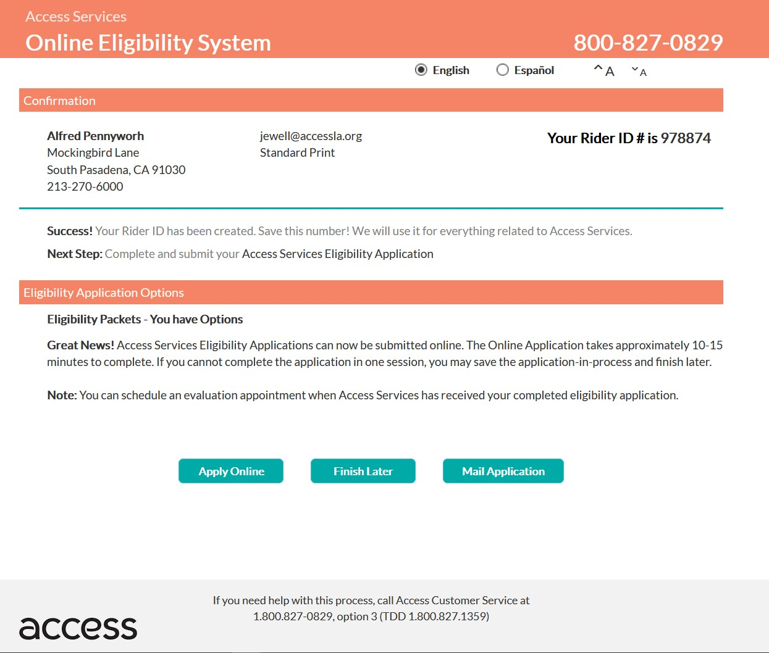
Notes:
Applicable federal regulations as interpreted by the courts require that all public fixed route operators must provide or certify there is provided ADA paratransit service complementary to its fixed route and which is designed, funded and implemented to fully meet all projected demand for next-day complementary ADA service. [49 C.F.R. 37.131(b)] The paratransit system must also be operated so as to be free of capacity constraints . [49 C.F.R.37.131(f)] Anderson v. Rochester-Genesee Regional Transp. Authority 337 F.3d 201, 210 -212 (C.A.2 (N.Y.),2003)
The assurances in Group 01.F are consistent with the U.S. OMB assurances required in the U.S. OMB SF-424B and SF-424D
1. Administrative Activities. On behalf of your Applicant, you assure that:
a. For every Project described in any application it submits, it has adequate
resources to properly plan, manage, and complete its Project, including the:
(1) Legal authority to apply for Federal funding,
(2) Institutional capability,
(3) Managerial capability, and
(4) Financial capability (including funds sufficient to pay the non-Federal share
of Project cost),

Slide 6
Notes:
Applicable federal regulations as interpreted by the courts require that all public fixed route operators must provide or certify there is provided ADA paratransit service complementary to its fixed route and which is designed, funded and implemented to fully meet all projected demand for next-day complementary ADA service. [49 C.F.R. 37.131(b)] The paratransit system must also be operated so as to be free of capacity constraints . [49 C.F.R.37.131(f)] Anderson v. Rochester-Genesee Regional Transp. Authority 337 F.3d 201, 210 -212 (C.A.2 (N.Y.),2003)
The assurances in Group 01.F are consistent with the U.S. OMB assurances required in the U.S. OMB SF-424B and SF-424D
1. Administrative Activities. On behalf of your Applicant, you assure that:
a. For every Project described in any application it submits, it has adequate
resources to properly plan, manage, and complete its Project, including the:
(1) Legal authority to apply for Federal funding,
(2) Institutional capability,
(3) Managerial capability, and
(4) Financial capability (including funds sufficient to pay the non-Federal share
of Project cost),

Slide 7
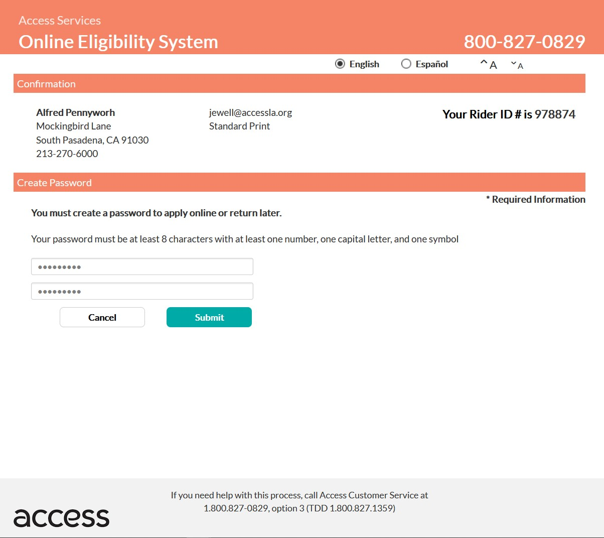
Notes:
Applicable federal regulations as interpreted by the courts require that all public fixed route operators must provide or certify there is provided ADA paratransit service complementary to its fixed route and which is designed, funded and implemented to fully meet all projected demand for next-day complementary ADA service. [49 C.F.R. 37.131(b)] The paratransit system must also be operated so as to be free of capacity constraints . [49 C.F.R.37.131(f)] Anderson v. Rochester-Genesee Regional Transp. Authority 337 F.3d 201, 210 -212 (C.A.2 (N.Y.),2003)
The assurances in Group 01.F are consistent with the U.S. OMB assurances required in the U.S. OMB SF-424B and SF-424D
1. Administrative Activities. On behalf of your Applicant, you assure that:
a. For every Project described in any application it submits, it has adequate
resources to properly plan, manage, and complete its Project, including the:
(1) Legal authority to apply for Federal funding,
(2) Institutional capability,
(3) Managerial capability, and
(4) Financial capability (including funds sufficient to pay the non-Federal share
of Project cost),

Slide 8
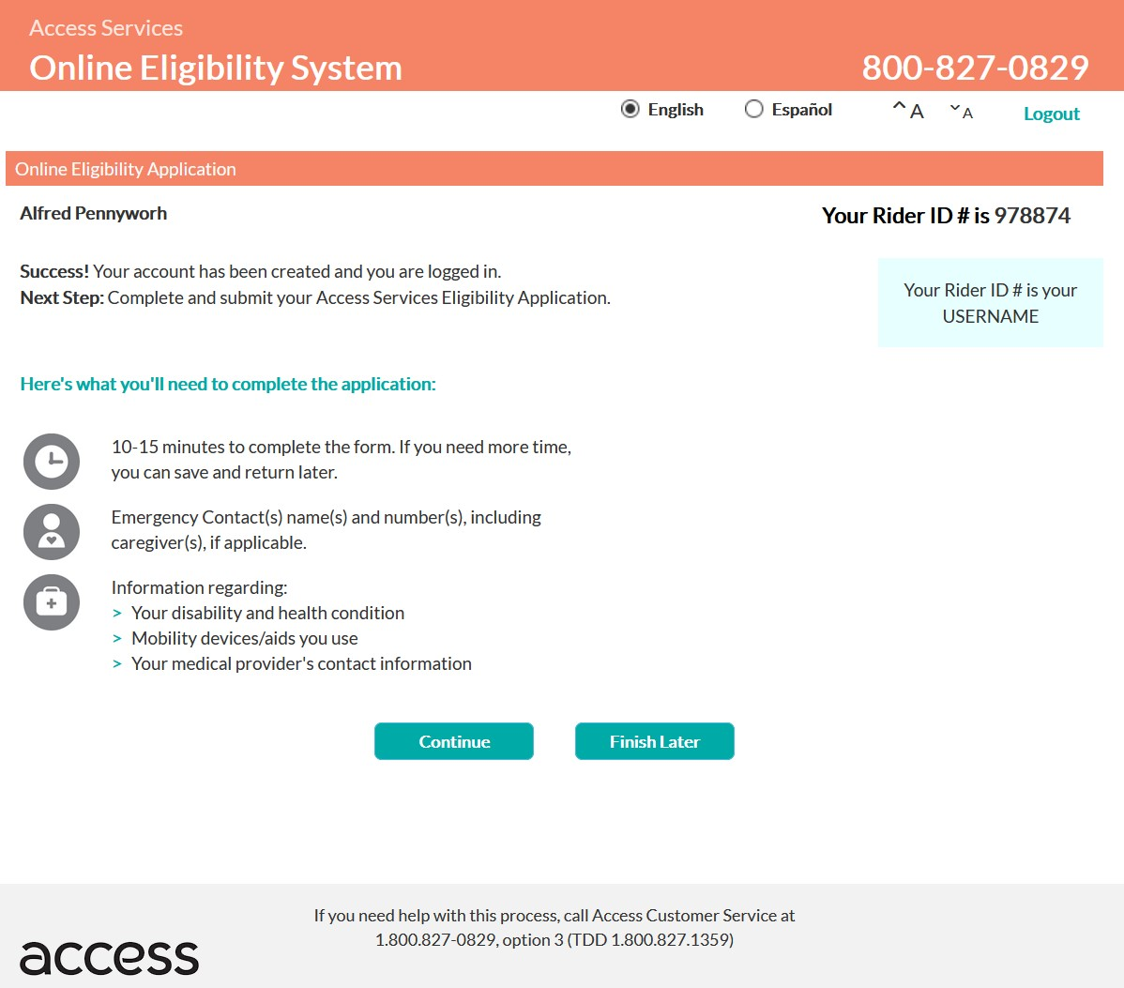
Notes:
Applicable federal regulations as interpreted by the courts require that all public fixed route operators must provide or certify there is provided ADA paratransit service complementary to its fixed route and which is designed, funded and implemented to fully meet all projected demand for next-day complementary ADA service. [49 C.F.R. 37.131(b)] The paratransit system must also be operated so as to be free of capacity constraints . [49 C.F.R.37.131(f)] Anderson v. Rochester-Genesee Regional Transp. Authority 337 F.3d 201, 210 -212 (C.A.2 (N.Y.),2003)
The assurances in Group 01.F are consistent with the U.S. OMB assurances required in the U.S. OMB SF-424B and SF-424D
1. Administrative Activities. On behalf of your Applicant, you assure that:
a. For every Project described in any application it submits, it has adequate
resources to properly plan, manage, and complete its Project, including the:
(1) Legal authority to apply for Federal funding,
(2) Institutional capability,
(3) Managerial capability, and
(4) Financial capability (including funds sufficient to pay the non-Federal share
of Project cost),

Slide 9
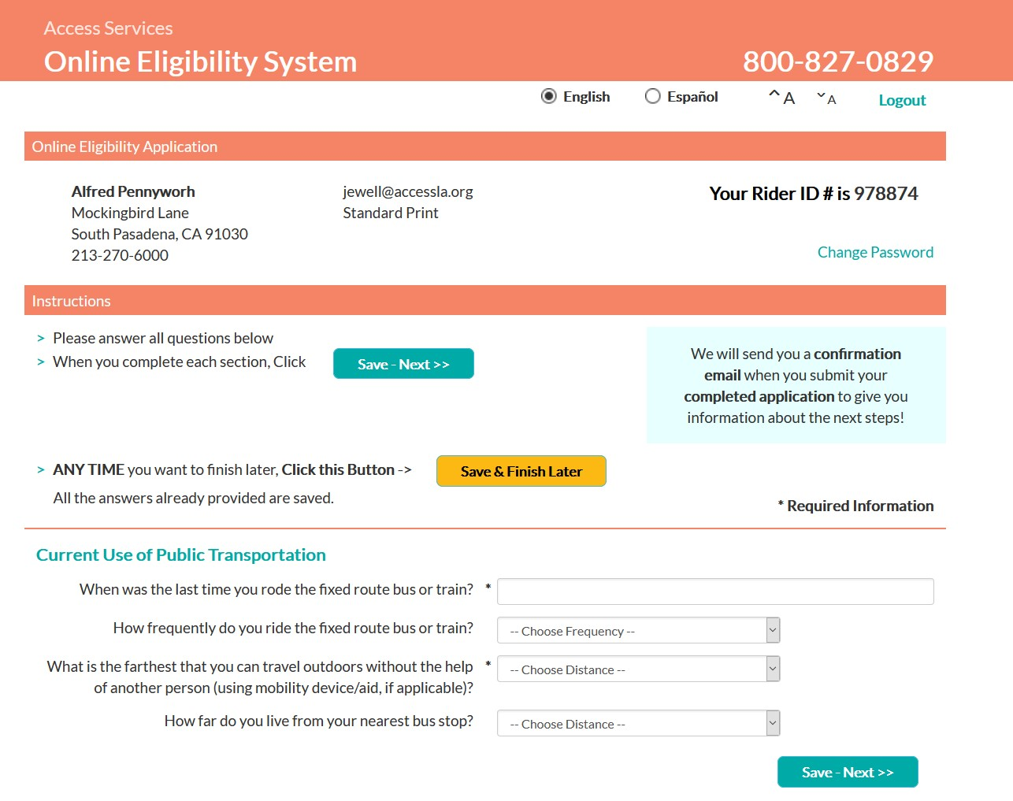
Notes:
Applicable federal regulations as interpreted by the courts require that all public fixed route operators must provide or certify there is provided ADA paratransit service complementary to its fixed route and which is designed, funded and implemented to fully meet all projected demand for next-day complementary ADA service. [49 C.F.R. 37.131(b)] The paratransit system must also be operated so as to be free of capacity constraints . [49 C.F.R.37.131(f)] Anderson v. Rochester-Genesee Regional Transp. Authority 337 F.3d 201, 210 -212 (C.A.2 (N.Y.),2003)
The assurances in Group 01.F are consistent with the U.S. OMB assurances required in the U.S. OMB SF-424B and SF-424D
1. Administrative Activities. On behalf of your Applicant, you assure that:
a. For every Project described in any application it submits, it has adequate
resources to properly plan, manage, and complete its Project, including the:
(1) Legal authority to apply for Federal funding,
(2) Institutional capability,
(3) Managerial capability, and
(4) Financial capability (including funds sufficient to pay the non-Federal share
of Project cost),

Slide 10
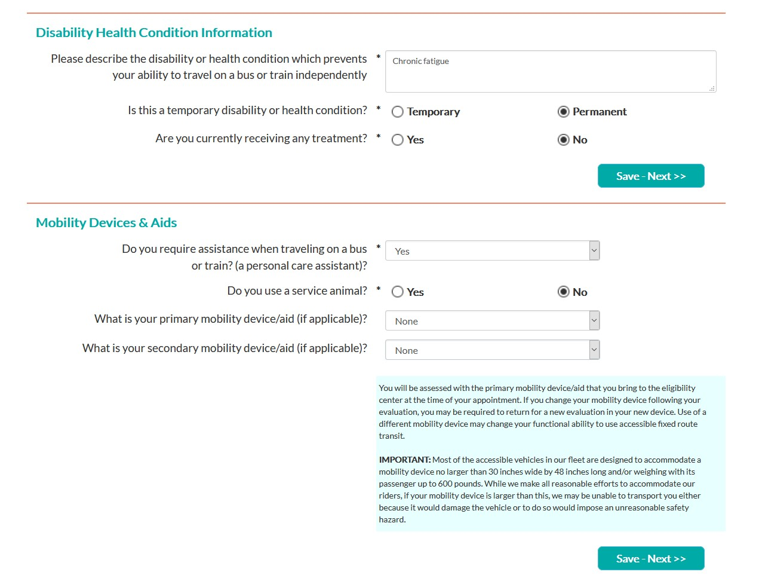
Notes:
Applicable federal regulations as interpreted by the courts require that all public fixed route operators must provide or certify there is provided ADA paratransit service complementary to its fixed route and which is designed, funded and implemented to fully meet all projected demand for next-day complementary ADA service. [49 C.F.R. 37.131(b)] The paratransit system must also be operated so as to be free of capacity constraints . [49 C.F.R.37.131(f)] Anderson v. Rochester-Genesee Regional Transp. Authority 337 F.3d 201, 210 -212 (C.A.2 (N.Y.),2003)
The assurances in Group 01.F are consistent with the U.S. OMB assurances required in the U.S. OMB SF-424B and SF-424D
1. Administrative Activities. On behalf of your Applicant, you assure that:
a. For every Project described in any application it submits, it has adequate
resources to properly plan, manage, and complete its Project, including the:
(1) Legal authority to apply for Federal funding,
(2) Institutional capability,
(3) Managerial capability, and
(4) Financial capability (including funds sufficient to pay the non-Federal share
of Project cost),

Slide 11
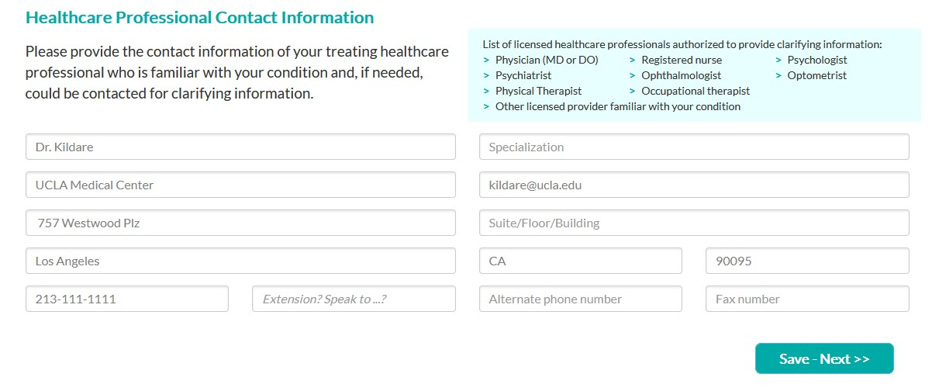
Notes:
Applicable federal regulations as interpreted by the courts require that all public fixed route operators must provide or certify there is provided ADA paratransit service complementary to its fixed route and which is designed, funded and implemented to fully meet all projected demand for next-day complementary ADA service. [49 C.F.R. 37.131(b)] The paratransit system must also be operated so as to be free of capacity constraints . [49 C.F.R.37.131(f)] Anderson v. Rochester-Genesee Regional Transp. Authority 337 F.3d 201, 210 -212 (C.A.2 (N.Y.),2003)
The assurances in Group 01.F are consistent with the U.S. OMB assurances required in the U.S. OMB SF-424B and SF-424D
1. Administrative Activities. On behalf of your Applicant, you assure that:
a. For every Project described in any application it submits, it has adequate
resources to properly plan, manage, and complete its Project, including the:
(1) Legal authority to apply for Federal funding,
(2) Institutional capability,
(3) Managerial capability, and
(4) Financial capability (including funds sufficient to pay the non-Federal share
of Project cost),

Slide 12
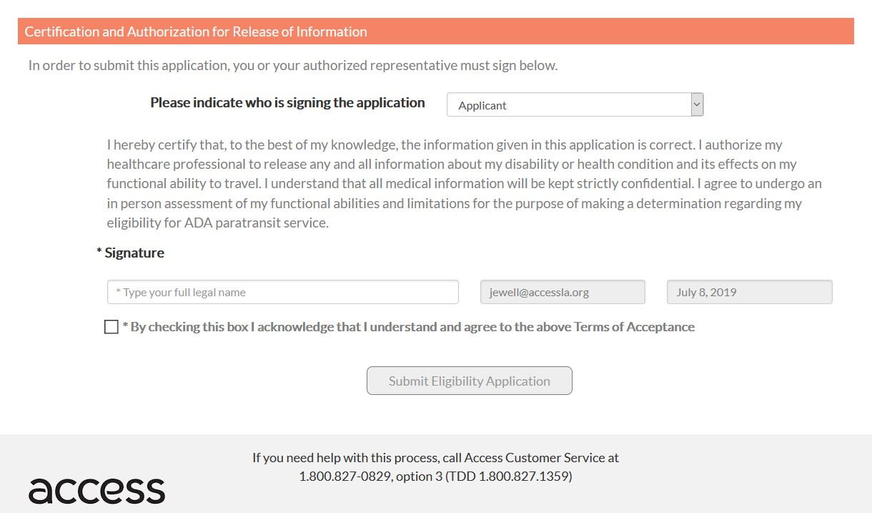
Notes:
Applicable federal regulations as interpreted by the courts require that all public fixed route operators must provide or certify there is provided ADA paratransit service complementary to its fixed route and which is designed, funded and implemented to fully meet all projected demand for next-day complementary ADA service. [49 C.F.R. 37.131(b)] The paratransit system must also be operated so as to be free of capacity constraints . [49 C.F.R.37.131(f)] Anderson v. Rochester-Genesee Regional Transp. Authority 337 F.3d 201, 210 -212 (C.A.2 (N.Y.),2003)
The assurances in Group 01.F are consistent with the U.S. OMB assurances required in the U.S. OMB SF-424B and SF-424D
1. Administrative Activities. On behalf of your Applicant, you assure that:
a. For every Project described in any application it submits, it has adequate
resources to properly plan, manage, and complete its Project, including the:
(1) Legal authority to apply for Federal funding,
(2) Institutional capability,
(3) Managerial capability, and
(4) Financial capability (including funds sufficient to pay the non-Federal share
of Project cost),

Slide 13
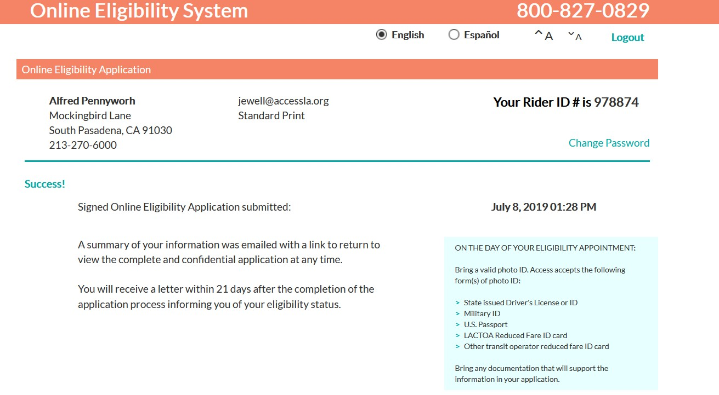
Notes:
Applicable federal regulations as interpreted by the courts require that all public fixed route operators must provide or certify there is provided ADA paratransit service complementary to its fixed route and which is designed, funded and implemented to fully meet all projected demand for next-day complementary ADA service. [49 C.F.R. 37.131(b)] The paratransit system must also be operated so as to be free of capacity constraints . [49 C.F.R.37.131(f)] Anderson v. Rochester-Genesee Regional Transp. Authority 337 F.3d 201, 210 -212 (C.A.2 (N.Y.),2003)
The assurances in Group 01.F are consistent with the U.S. OMB assurances required in the U.S. OMB SF-424B and SF-424D
1. Administrative Activities. On behalf of your Applicant, you assure that:
a. For every Project described in any application it submits, it has adequate
resources to properly plan, manage, and complete its Project, including the:
(1) Legal authority to apply for Federal funding,
(2) Institutional capability,
(3) Managerial capability, and
(4) Financial capability (including funds sufficient to pay the non-Federal share
of Project cost),

Slide 14
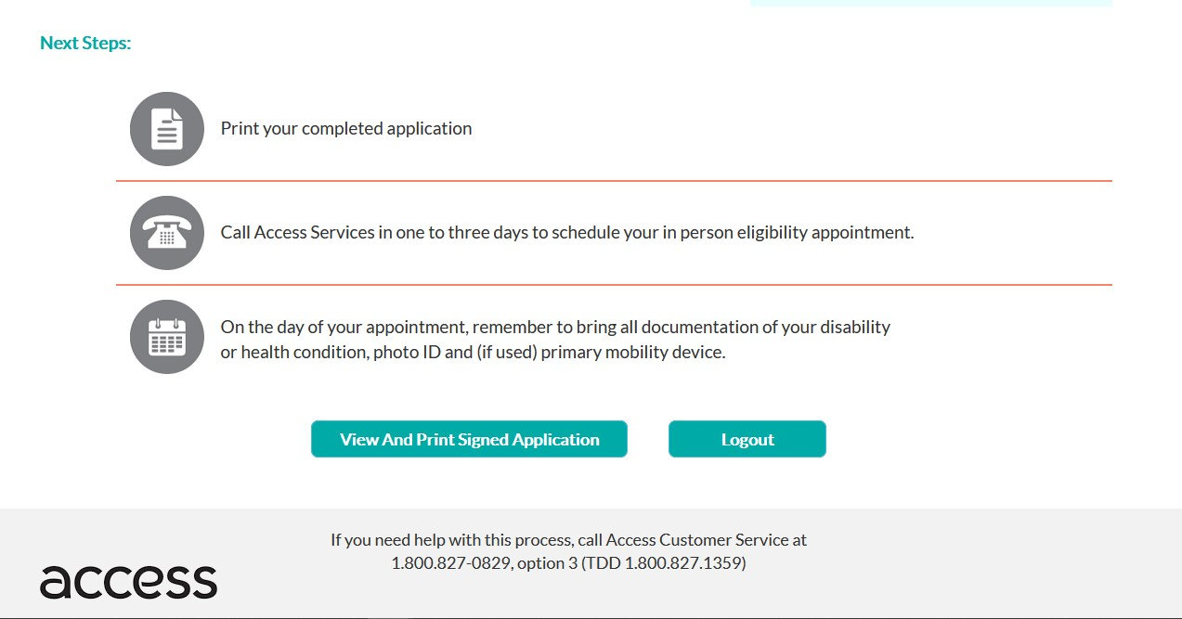
Notes:
Applicable federal regulations as interpreted by the courts require that all public fixed route operators must provide or certify there is provided ADA paratransit service complementary to its fixed route and which is designed, funded and implemented to fully meet all projected demand for next-day complementary ADA service. [49 C.F.R. 37.131(b)] The paratransit system must also be operated so as to be free of capacity constraints . [49 C.F.R.37.131(f)] Anderson v. Rochester-Genesee Regional Transp. Authority 337 F.3d 201, 210 -212 (C.A.2 (N.Y.),2003)
The assurances in Group 01.F are consistent with the U.S. OMB assurances required in the U.S. OMB SF-424B and SF-424D
1. Administrative Activities. On behalf of your Applicant, you assure that:
a. For every Project described in any application it submits, it has adequate
resources to properly plan, manage, and complete its Project, including the:
(1) Legal authority to apply for Federal funding,
(2) Institutional capability,
(3) Managerial capability, and
(4) Financial capability (including funds sufficient to pay the non-Federal share
of Project cost),

Slide 15
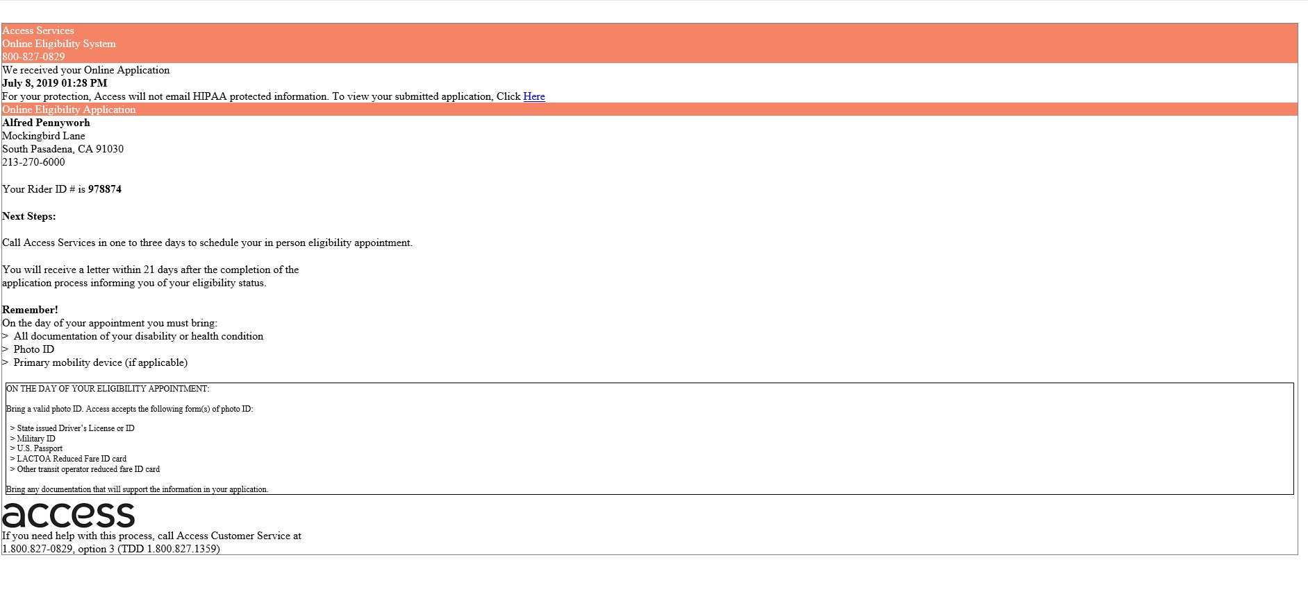
Notes:
Applicable federal regulations as interpreted by the courts require that all public fixed route operators must provide or certify there is provided ADA paratransit service complementary to its fixed route and which is designed, funded and implemented to fully meet all projected demand for next-day complementary ADA service. [49 C.F.R. 37.131(b)] The paratransit system must also be operated so as to be free of capacity constraints . [49 C.F.R.37.131(f)] Anderson v. Rochester-Genesee Regional Transp. Authority 337 F.3d 201, 210 -212 (C.A.2 (N.Y.),2003)
The assurances in Group 01.F are consistent with the U.S. OMB assurances required in the U.S. OMB SF-424B and SF-424D
1. Administrative Activities. On behalf of your Applicant, you assure that:
a. For every Project described in any application it submits, it has adequate
resources to properly plan, manage, and complete its Project, including the:
(1) Legal authority to apply for Federal funding,
(2) Institutional capability,
(3) Managerial capability, and
(4) Financial capability (including funds sufficient to pay the non-Federal share
of Project cost),

Slide 16
Schedule
Deploy within next 1-2 weeks
Evaluate next 2-4 months
Expand to allow for on-line renewals

