Slide 1
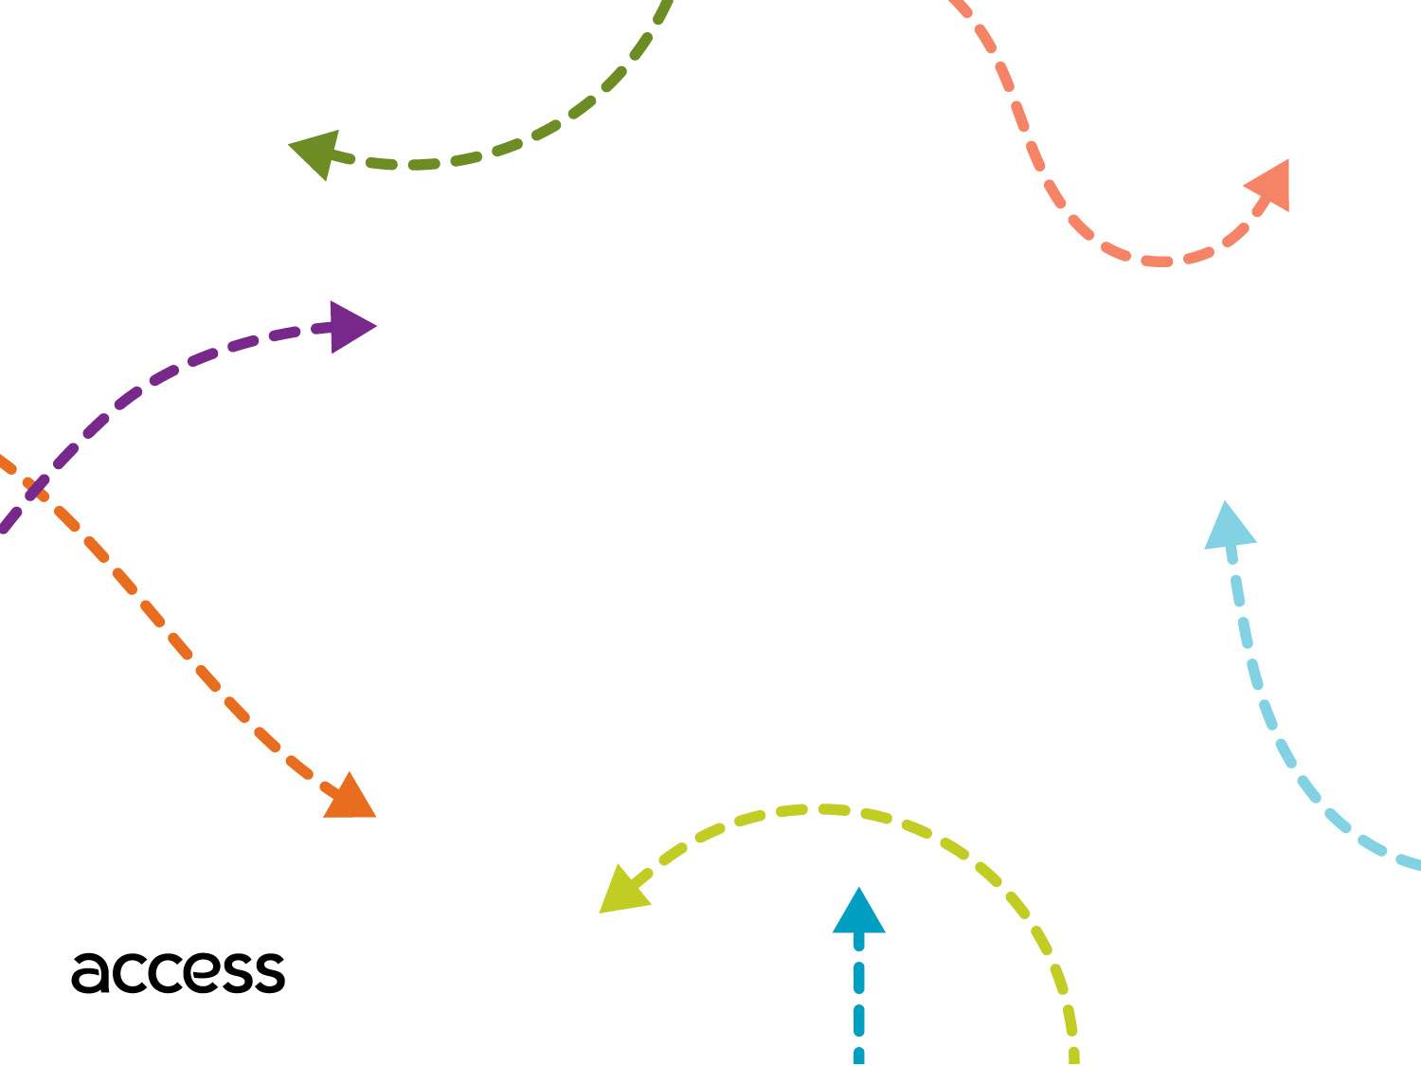
Operations Update
Transportation Professionals Advisory
Committee (TPAC)
March 9,2019

Slide 2
Performance Statistics
 | *Apr-19 | FY19
Vehicle Trips Completed | 301,994 | 2,880,082
Passenger Trips Completed | 387,880 | 3,719,162
Reservation Calls Answered | 252,391 | 2,585,549
ETA Calls Answered | 46,092 | 519,137
WMR ETAs Requested | 309,639 | 1,850,306
*not final

Slide 3
Performance Report Card- System Wide
 | Standard | *Apr-19 | FY19
Completed Trips | - | 301,994 | 2,880,082
On Time Performance | ≥ 91% | 92.1% | 92.1%
Excessively Late Trips | ≤ 0.10% | 0.03% | 0.08%
Excessively Long Trips | ≤ 5% | 2.5% | 3.9%
Missed Trips | ≤ 0.75% | 0.35% | 0.55%
Denials | ≤ 0 | 3 | 7
Access to Work On Time Performance | ≥ 94% | 97.4% | 95.8%
Average Hold Time (Reservations) | ≤ 120 | 78 | 82
Calls On Hold > 5 Min (Reservations) | ≤ 5% | 3.0% | 4.3%
Calls On Hold > 5 Min (ETA) | ≤ 10% | 2.8% | 5.6%
Complaints Per 1,000 Trips | ≤ 4.0 | 2.4 | 3.4
Preventable Incident Rate | ≤ 0.25 | 0.30 | 0.21
Preventable Collision Rate | ≤ 0.50 | 0.93 | 0.70
Miles Between Road Calls | ≥ 25,000 | - | 47,303
*not final

Slide 4
Antelope Valley Region
Key Performance Indicator | Standard | Contractual | *Apr-19 | FY19
Completed Trips | - |  | 13,689 | 133,048
On Time Performance | ≥ 91% | ✓ | 91.2% | 92.0%
Excessively Late Trips | ≤ 0.10% | ✓ | 0.05% | 0.10%
Excessively Long Trips | ≤ 5% |  | 2.4% | 2.1%
Missed Trips | ≤ 0.75% |  | 0.82% | 0.88%
Denials | ≤ 0 | ✓ | 0 | 1
Access to Work On Time Performance | ≥ 92% | ✓ | 95.5% | 97.0%
Average Hold Time (Reservations) | ≤ 120 | ✓ | 86 | 91
Calls On Hold > 5 Min (Reservations) | ≤ 5% | ✓ | 2.0% | 4.2%
Calls On Hold > 5 Min (ETA) | ≤ 10% |  | 2.5% | 2.0%
Complaints Per 1,000 Trips | ≤ 4.0 |  | 3.4 | 2.4
Preventable Incident Rate | ≤ 0.25 |  | 0.59 | 0.18
Preventable Collision Rate | ≤ 0.50 | ✓ | 0.44 | 0.64
Miles Between Road Calls | ≥ 25,000 |  | - | 28,845
*not final

Slide 5
Antelope Valley Region
Preventable Incident Rate:
Two incidents for the month of April.
Drivers were coached on best practices.
Preventable Collisions Rate:
Performance Letter and Liquidated Damages are being assessed for 3rd Quarter.

Slide 6
Eastern Region
Key Performance Indicator | Standard | Contractual | *Apr-19 | FY19
Completed Trips | - |  | 89,441 | 855,689
On Time Performance | ≥ 91% | ✓ | 91.0% | 92.1%
Excessively Late Trips | ≤ 0.10% | ✓ | 0.03% | 0.08%
Excessively Long Trips | ≤ 5% | ✓ | 0.80% | 1.1%
Missed Trips | ≤ 0.75% | ✓ | 0.37% | 0.39%
Denials | ≤ 0 | ✓ | 0 | 1
Access to Work On Time Performance | ≥ 95% | ✓ | 95.6% | 95.1%
Average Hold Time (Reservations) | ≤ 120 | ✓ | 45 | 65
Calls On Hold > 5 Min (Reservations) | ≤ 5% | ✓ | 1.7% | 4.8%
Calls On Hold > 5 Min (ETA) | ≤ 10% | ✓ | 1.5% | 3.3%
Complaints Per 1,000 Trips | ≤ 4.0 | ✓ | 3.0 | 3.1
Preventable Incident Rate | ≤ 0.25 | ✓ | 0.20 | 0.19
Preventable Collision Rate | ≤ 0.50 | ✓ | 1.00 | 0.78
Miles Between Road Calls | ≥ 25,000 | ✓ | - | 92,362
*not final

Slide 7
Eastern Region
Preventable Collisions Rate:
Performance Letter and Liquidated Damages are being assessed for 3rd Quarter.
SGT is reviewing safety trends on drivers to work towards coaching improvements since a majority of these incidents are minor or no damage or injury.

Slide 8
Northern Region
Key Performance Indicator | Standard | Contractual | *Apr-19 | FY19
Completed Trips | - |  | 53,392 | 508,164
On Time Performance | ≥ 91% | ✓ | 92.5% | 92.0%
Excessively Late Trips | ≤ 0.10% | ✓ | 0.07% | 0.09%
Excessively Long Trips | ≤ 5% | ✓ | 4.0% | 5.4%
Missed Trips | ≤ 0.75% | ✓ | 0.29% | 0.35%
Denials | ≤ 0 | ✓ | 1 | 1
Access to Work On Time Performance | ≥ 94% | ✓ | 98.1% | 95.3%
Average Hold Time (Reservations) | ≤ 120 | ✓ | 132 | 107
Calls On Hold > 5 Min (Reservations) | ≤ 5% | ✓ | 4.5% | 3.5%
Calls On Hold > 5 Min (ETA) | ≤ 10% | ✓ | 4.3% | 4.4%
Complaints Per 1,000 Trips | ≤ 4.0 | ✓ | 1.7 | 2.1
Preventable Incident Rate | ≤ 0.25 | ✓ | 0.16 | 0.20
Preventable Collision Rate | ≤ 0.50 | ✓ | 1.42 | 0.83
Miles Between Road Calls | ≥ 25,000 | ✓ | - | 80,302
*not final

Slide 9
Northern Region
Denial:
Contractor coached the CSR that caused the denial.
Average Hold Time (Reservations):
Adjustments have been made to staffing schedule to meet the need of the peak times for CSRs.
Preventable Collision Rate:
Performance Letter and Liquidated Damages are being assessed for 3rd Quarter.
Safety blitzes and topics of the month have been implemented to encourage safer driving practices.

Slide 10
Santa Clarita Region
Key Performance Indicator | Standard | Contractual | *Apr-19 | FY19
Completed Trips | - |  | - | 28,102
On Time Performance | ≥ 91% | ✓ | - | 94.4%
Excessively Late Trips | ≤ 0.10% | ✓ | - | 0.07%
Excessively Long Trips | ≤ 5% | ✓ | - | 3.0%
Missed Trips | ≤ 0.75% | ✓ | - | 0.90%
Denials | ≤ 0 | ✓ | 1 | 2
Access to Work On Time Performance | ≥ 94% | ✓ | - | -
Average Hold Time (Reservations) | ≤ 120 | ✓ | 39 | 40
Calls On Hold > 5 Min (Reservations) | ≤ 5% | ✓ | 1.3% | 1.2%
Calls On Hold > 5 Min (ETA) | ≤ 10% | ✓ | 2.0% | 2.3%
Complaints Per 1,000 Trips | ≤ 4.0 | ✓ | * | 0.8
Preventable Incident Rate | ≤ 0.25 | ✓ | 0.00 | 0.48
Preventable Collision Rate | ≤ 0.50 | ✓ | 0.00 | 0.72
Miles Between Road Calls | ≥ 25,000 | ✓ | - | 197,202
*not final

Slide 11
Santa Clarita Region
Denial:
Contractor coached the CSR that caused the denial.

Slide 12
Southern Region
Key Performance Indicator | Standard | Contractual | *Apr-19 | FY19
Completed Trips | - |  | 98,030 | 909,557
On Time Performance | ≥ 91% | ✓ | 93.0% | 92.0%
Excessively Late Trips | ≤ 0.10% | ✓ | 0.01% | 0.09%
Excessively Long Trips | ≤ 5% | ✓ | 3.3% | 6.3%
Missed Trips | ≤ 0.75% | ✓ | 0.25% | 0.87%
Denials | ≤ 0 | ✓ | 0 | 2
Access to Work On Time Performance | ≥ 92% | ✓ | 98.5% | 96.4%
Average Hold Time (Reservations) | ≤ 120 | ✓ | 100 | 91
Calls On Hold > 5 Min (Reservations) | ≤ 5% | ✓ | 4.2% | 3.7%
Calls On Hold > 5 Min (ETA) | ≤ 10% | ✓ | 3.9% | 8.2%
Complaints Per 1,000 Trips | ≤ 4.0 | ✓ | 2.1 | 5.1
Preventable Incident Rate | ≤ 0.25 | ✓ | 0.49 | 0.30
Preventable Collision Rate | ≤ 0.50 | ✓ | 0.64 | 0.61
Miles Between Road Calls | ≥ 25,000 | ✓ | - | 28,997
*not final

Slide 13
Southern Region
Preventable Incident Rate:
Every incident is discussed with Driver and is coached on best practices.
Preventable Collision Rate:
Performance Letter and Liquidated Damages are being assessed for 3rd Quarter.
Contractor is working with the safety team to improve performance.

Slide 14
West Central Region
Key Performance Indicator | Standard | Contractual | *Apr-19 | FY19
Completed Trips | - |  | 47,442 | 445,522
On Time Performance | ≥ 91% | ✓ | 91.4% | 91.9%
Excessively Late Trips | ≤ 0.10% | ✓ | 0.04% | 0.06%
Excessively Long Trips | ≤ 5% |  | 2.3% | 3.5%
Missed Trips | ≤ 0.75% |  | 0.47% | 0.43%
Denials | ≤ 0 | ✓ | 1 | 2
Access to Work On Time Performance | ≥ 91% | ✓ | 95.8% | 97.2%
Average Hold Time (Reservations) | ≤ 120 | ✓ | 45 | 66
Calls On Hold > 5 Min (Reservations) | ≤ 5% | ✓ | 1.9% | 5.0%
Calls On Hold > 5 Min (ETA) | ≤ 5% | ✓ | 0.9% | 3.3%
Complaints Per 1,000 Trips | ≤ 4.0 | ✓ | 2.5 | 2.5
Preventable Incident Rate | ≤ 0.25 |  | 0.00 | 0.08
Preventable Collision Rate | ≤ 0.50 | ✓ | 0.95 | 0.59
Miles Between Road Calls | ≥ 25,000 | ✓ | - | 49,781
*not final

Slide 15
West Central Region
Denial:
Contractor coached the CSR that caused the denial.
Preventable Collision Rate:
Performance Letter and Liquidated Damages are being assessed for 3rd Quarter.
CTI continues to educate drivers through training and coaching to minimize collisions.

Slide 16
Abandoned Calls - Reservations
 | *Apr-19 |  | FY19
 | Total Calls | Abandoned Calls | Total Calls | Abandoned Calls
Antelope Valley | 9,431 | 2.3% | 92,097 | 1.6%
Eastern | 75,212 | 1.1% | 749,540 | 2.0%
Northern | 43,719 | 7.4% | 453,365 | 2.7%
Santa Clarita | 3,120 | 1.9% | 29,045 | 0.9%
Southern | 88,150 | 3.0% | 874,868 | 2.4%
West Central | 47,899 | 1.0% | 506,252 | 1.8%
 | 267,531 | 2.8% | 2,705,167 | 2.2%
*not final

Slide 17
Excessively Long Trips
 | *Apr-19 |  | FY19
 | Taxi | Employee | Taxi | Employee
Antelope Valley | - | 2.3% | - | 2.0%
Eastern | 1.3% | 0.0% | 1.3% | 0.8%
Northern | 5.3% | 3.1% | 2.4% | 7.2%
Santa Clarita | - | - | - | 2.8%
Southern | 2.4% | 4.6% | 2.9% | 10.9%
West Central | 1.9% | 2.7% | 3.0% | 4.1%
 | 2.3% | 2.7% | 2.3% | 5.7%
*not final

Slide 18
Highlights
Regional project administrator attended the Transition 2 Independence event in Lancaster, hosted by State Senator Scott Wilk and Assemblyman Tom Lackey.
Access partnered with AVTA to setup coupon sales at their Administrative Headquarters in Lancaster.
Access collaborated with customers to shoot a mobility device training video.
Operations staff and Board Member participated in a wheelchair-powered tour of Rancho Los Amigos in Downey.

Slide 19
Thank you for joining us.

