Slide 1
Operations Update
Transportation Professionals Advisory Committee (TPAC)
August 9, 2018

Slide 2
System-wide Performance Report Card
Key Performance Indicator | Standard | July-18 | FY18
On Time Performance | ≥ 91% | 94.0% | 92.1%
Excessively Late Trips | ≤ 0.10% | 0.03% | 0.07%
Excessively Long Trips | ≤ 5% | 3.9% | 4.7%
Missed Trips | ≤ 0.75% | 0.59% | 0.73%
Denials | 0 | 0 | 14
Access to Work On Time Performance | ≥ 94% | 97.0% | 94.9%
Average Hold Time (Reservations) | ≤ 120 | 70 | 83
Calls On Hold > 5 Min (Reservations) | ≤ 5% | 4.3% | 5.1%
Calls On Hold > 5 Min (ETA) | ≤ 10% | 5.3% | 15.6%
Complaints Per 1,000 Trips | ≤ 4.0 | 3.2 | 3.4
Preventable Incidents | ≤ 0.25 | * | 0.20
Preventable Collisions | ≤ 0.50 | * | 0.68
Miles Between Road Calls | ≥ 25,000 | * | 36,222
*data not final

Slide 3
Southern Region Performance Report Card
Key Performance Indicator | Standard | July-18 | FY18
On Time Performance | ≥ 91% | 93.2% | 90.9%
Excessively Late Trips | ≤ 0.10% | 0.07% | 0.09%
Excessively Long Trips | ≤ 5% | 6.9% | 7.7%
Missed Trips | ≤ 0.75% | 1.12% | 1.08%
Denials | 0 | 0 | 5
Access to Work On Time Performance | ≥ 94% | 96.5% | 95.0%
Average Hold Time (Reservations) | ≤ 120 | 64 | 87
Calls On Hold > 5 Min (Reservations) | ≤ 5% | 3.1% | 4.3%
Calls On Hold > 5 Min (ETA) | ≤ 10% | 7.1% | 21.0%
Complaints Per 1,000 Trips | ≤ 4.0 | 4.9 | 5.8
Preventable Incidents | ≤ 0.25 | * | 0.21
Preventable Collisions | ≤ 0.50 | * | 0.65
Miles Between Road Calls | ≥ 25,000 | * | 22,948
*data not final

Slide 4
Eastern Region Performance Report Card
Key Performance Indicator | Standard | July-18 | FY18
On Time Performance | ≥ 91% | 95.7% | 93.1%
Excessively Late Trips | ≤ 0.10% | 0.00% | 0.05%
Excessively Long Trips | ≤ 5% | 0.8% | 1.2%
Missed Trips | ≤ 0.75% | 0.14% | 0.36%
Denials | 0 | 0 | 1
Access to Work On Time Performance | ≥ 94% | 97.2% | 95.4%
Average Hold Time (Reservations) | ≤ 120 | 67 | 79
Calls On Hold > 5 Min (Reservations) | ≤ 5% | 5.6% | 6.5%
Calls On Hold > 5 Min (ETA) | ≤ 10% | 3.7% | 9.0%
Complaints Per 1,000 Trips | ≤ 4.0 | 2.6 | 2.8
Preventable Incidents | ≤ 0.25 | * | 0.17
Preventable Collisions | ≤ 0.50 | * | 0.79
Miles Between Road Calls | ≥ 25,000 | * | 56,463
*data not final

Slide 5
West-Central Performance Report Card
Key Performance Indicator | Standard | July-18 | FY18
On Time Performance | ≥ 91% | 94.5% | 92.4%
Excessively Late Trips | ≤ 0.10% | 0.01% | 0.05%
Excessively Long Trips | ≤ 5% | 2.8% | 3.5%
Missed Trips | ≤ 0.75% | 0.27% | 0.5%
Denials | ≤ 0% | 0 | 1
Access to Work On Time Performance | ≥ 94% | 99.1% | 96.3%
Average Hold Time (Reservations) | ≤ 120 | 68 | 79
Calls On Hold > 5 Min (Reservations) | ≤ 5% | 5.8% | 6.7%
Calls On Hold > 5 Min (ETA) | ≤ 5% | 3.6% | 8.5%
Complaints Per 1,000 Trips | ≤ 4.0 | 2.3 | 2.3
Preventable Incidents | ≤ 0.25 | * | 0.18
Preventable Collisions | ≤ 0.50 | * | 0.75
Miles Between Road Calls | ≥ 25,000 | * | 50,937
*data not final

Slide 6
Northern Region Performance Report Card
Key Performance Indicator | Standard | July-18 | FY18
On Time Performance | ≥ 91% | 92.1% | 92.10%
Excessively Late Trips | ≤ 0.10% | 0.03% | 0.08%
Excessively Long Trips | ≤ 5% | 5.6% | 6.8%
Missed Trips | ≤ 0.75% | 0.48% | 0.75%
Denials | ≤ 0% | 0 | 2
Access to Work On Time Performance | ≥ 94% | 96.7% | 93.40%
Average Hold Time (Reservations) | ≤ 120 | 95 | 91
Calls On Hold > 5 Min (Reservations) | ≤ 5% | 3.2% | 3.5%
Calls On Hold > 5 Min (ETA) | ≤ 10% | 2.8% | 3.4%
Complaints Per 1,000 Trips | ≤ 4.0 | 2.2 | 1.7
Preventable Incidents | ≤ 0.25 | * | 0.23
Preventable Collisions | ≤ 0.50 | * | 0.59
Miles Between Road Calls | ≥ 25,000 | * | 58,685
*data not final

Slide 7
Antelope Valley Performance Report Card
Key Performance Indicator | Standard | July-18 | FY18
On Time Performance | ≥ 91% | 92.6% | 91.6%
Excessively Late Trips | ≤ 0.10% | 0.03% | 0.08%
Excessively Long Trips | ≤ 5% | 1.9% | 2.5%
Missed Trips | ≤ 0.75% | 1.01% | 0.88%
Denials | 0 | 0 | 4
Access to Work On Time Performance | ≥ 94% | 100.0% | 97.6%
Average Hold Time (Reservations) | ≤ 120 | 55 | 85
Calls On Hold > 5 Min (Reservations) | ≤ 5% | 2.5% | 2.3%
Calls On Hold > 5 Min (ETA) | ≤ 10% | 1.6% | 1.1%
Complaints Per 1,000 Trips | ≤ 4.0 | 2.1 | 2.3
Preventable Incidents | ≤ 0.25 | * | 0.16
Preventable Collisions | ≤ 0.50 | * | 0.36
Miles Between Road Calls | ≥ 25,000 | * | 22,160
*data not final

Slide 8
Santa Clarita Performance Report Card
Key Performance Indicator | Standard | July-18 | FY18
On Time Performance | ≥ 91% | 95.5% | 94.9%
Excessively Late Trips | ≤ 0.10% | 0.06% | 0.05%
Excessively Long Trips | ≤ 5% | 2.2% | 3.1%
Missed Trips | ≤ 0.75% | 1.00% | 0.87%
Denials | 0 | 0 | 1
Access to Work On Time Performance | ≥ 94% | NA | NA
Average Hold Time (Reservations) | ≤ 120 | 45 | 53
Calls On Hold > 5 Min (Reservations) | ≤ 5% | 1.5% | 2.2%
Calls On Hold > 5 Min (ETA) | ≤ 10% | NA | NA
Complaints Per 1,000 Trips | ≤ 4.0 | 0.7 | 0.6
Preventable Incidents | ≤ 0.25 | * | 1.47
Preventable Collisions | ≤ 0.50 | * | 0.37
Miles Between Road Calls | ≥ 25,000 | * | 68,218
*data not final

Slide 9
Abandoned Reservation Calls
 | Jul-18 |  | FY18
 | Total Calls | Abandoned Calls | Total Calls | Abandoned Calls
Antelope Valley | 8,437 | 1.6% | 98,288 | 1.5%
Eastern | 72,744 | 1.8% | 862,215 | 2.2%
Northern | 43,542 | 1.7% | 550,264 | 1.6%
Santa Clarita | 3,617 | 0.9% | 44,603 | 1.0%
Southern | 86,041 | 1.6% | 1,153,314 | 2.0%
West Central | 51,470 | 1.3% | 623,413 | 2.0%
 | 265,851 | 1.7% | 3,332,097 | 2.1%

Slide 10
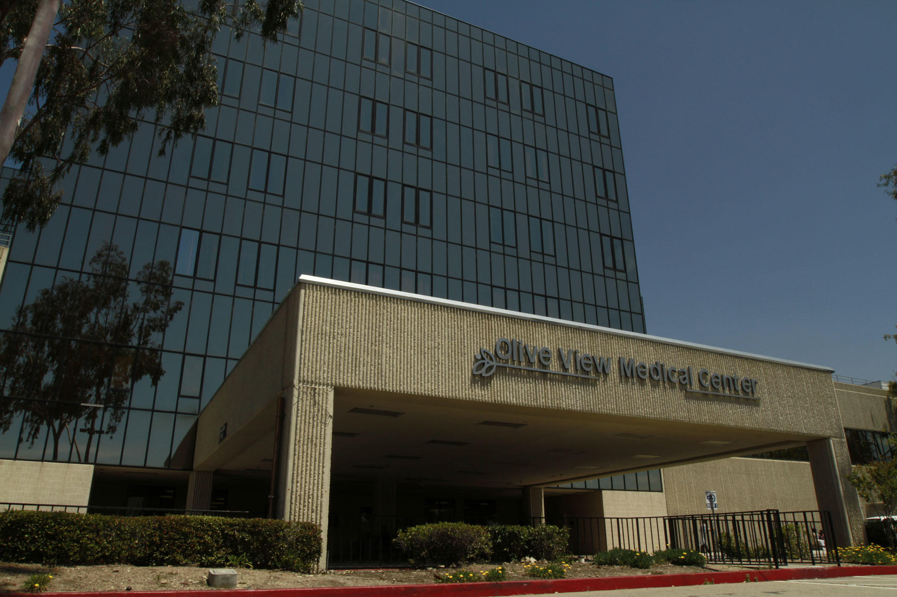
Olive View Transportation Coordinator (Starter)
Started on August 1, 2018 as part of new Northern region contract
Located at Olive View Medical Center in Sylmar
Monitors and facilitates transportation
Assists with transfer trips
Additional transportation coordinators are stationed at Braille Los Angeles and Rancho Los Amigos in Downey
4,618 trips have been performed at Olive View in the last 6 months. It is the #4 trip generator in the system.
Notes:
#1 trip gen: Braille, 2 Rancho, 3 VA West LA

Slide 11
New vehicles
4 Dodge Caravans were delivered to the West-Central region in July.
10 Caravans are being delivered to the Southern region in August.
4 new cutaways were provided for the Antelope Valley region starting in May.
Notes:
#1 trip gen: Braille, 2 Rancho, 3 VA West LA

Slide 12
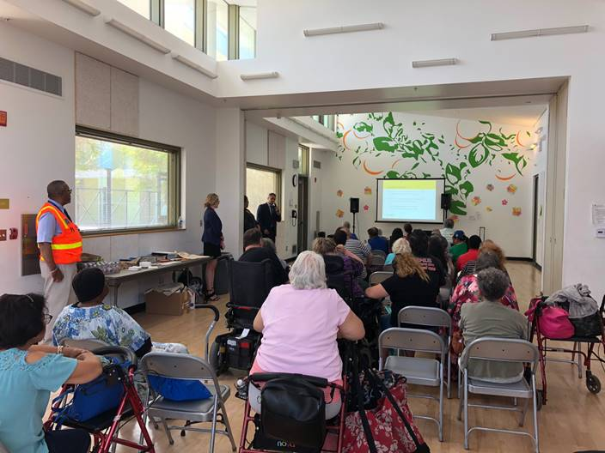
Community Meeting Highlights
Community meetings were held in all regions during June and July
142 people attended including 118 riders
Presentations regarding Where’s My Ride and Operational Performance were provided to riders
A question and answer session was held at each meeting
Common rider concerns included travel time, share rides and routing
Notes:
#1 trip gen: Braille, 2 Rancho, 3 VA West LA

