Slide 1
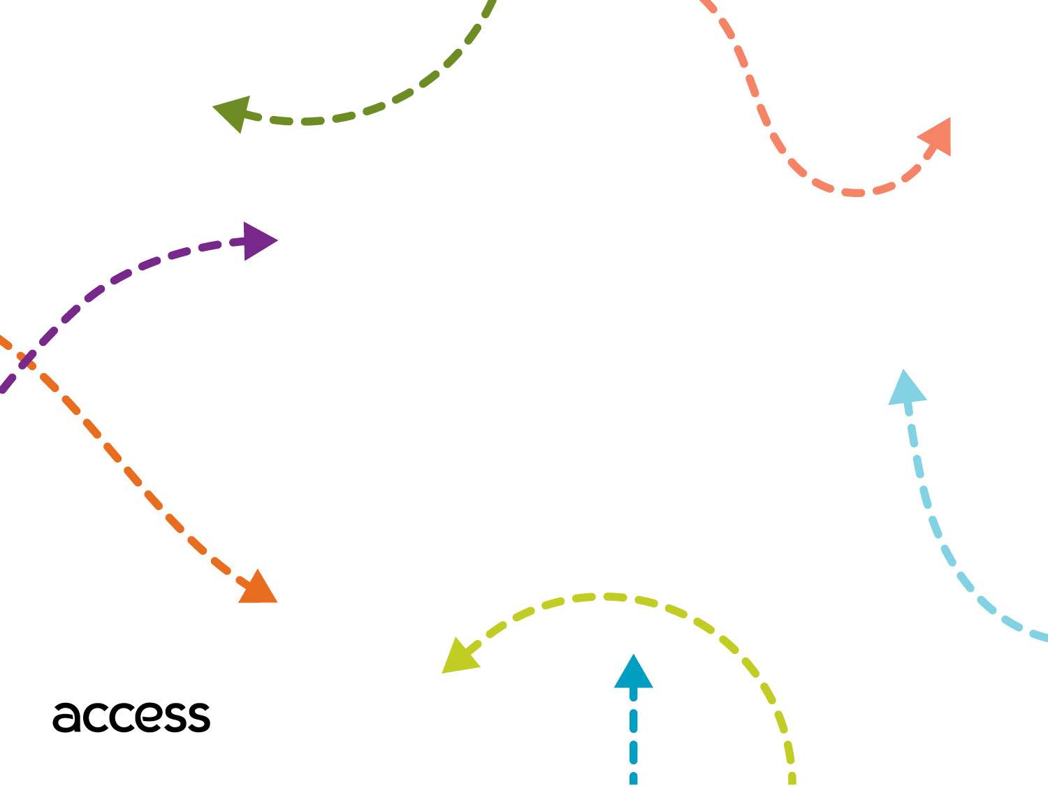
Standing Orders
Transportation Professionals Advisory Committee (TPAC)
March 9, 2019

Slide 2
What are Standing Orders?
Standing Orders are a series of rides for an extended period of time on the same day(s) of the week, at the same pick-up time and from the same pick-up/drop of address.
These rides are also known as Subscription Trips.
Customers may request Standing Order trips if they will be taking this series of rides for more than six weeks.

Slide 3
Current Process
Customer submits Standing Order request with a requested pick up time.
Contractors reach out to customers within 5 business days to negotiate the request time.
The Negotiation Process takes place during this call.
Once trip is confirmed with the customer, the contractor will provide a Standing Order start date.
Customer will be sent trips on a regular basis without needing to call to schedule the day before.
If trip cannot be confirmed, the trip is placed in the Standing Order Waitlist.

Slide 4
Standing Orders Waitlist
Standing Orders are placed on the Waitlist under these circumstances:
The customer refuses the negotiated time.
Contractor has inaccurate contact information.
Customer does not answer the multiple attempts to be reached or do not call back to get their status.

Slide 5
Customers with Standing Orders
Nov 2018 – April 2019

Slide 6
Most Popular Standing Order Times

Slide 7
Standing Order Trip Volume

Slide 8
Questions?

