Slide 1
New Access Website

Slide 2
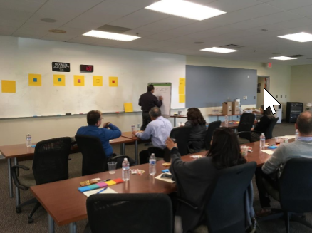
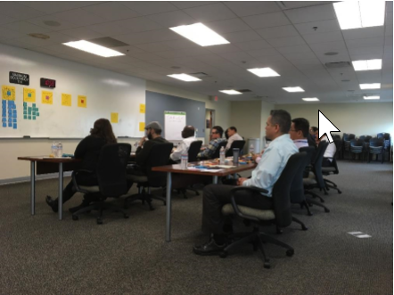
Website Redesign Processes
Several focus group meetings have been held in 2018 to gather user inputs as the baseline for the new website.
The top three insights of the new website generated from the focus group meeting:
1. Clearly Communicate the Process to Apply
2. Engage the Rider on the Website
3. Incorporate the Three Key Values
a) Curb-to-Curb Service/Accessibility
b) Caring Community
c) Independence/Freedom
New website is scheduling to go-live in October 2019 that fully compliance with WCAG (Web Content Accessibility Guideline).
Notes:
Applicable federal regulations as interpreted by the courts require that all public fixed route operators must provide or certify there is provided ADA paratransit service complementary to its fixed route and which is designed, funded and implemented to fully meet all projected demand for next-day complementary ADA service. [49 C.F.R. 37.131(b)] The paratransit system must also be operated so as to be free of capacity constraints . [49 C.F.R.37.131(f)] Anderson v. Rochester-Genesee Regional Transp. Authority 337 F.3d 201, 210 -212 (C.A.2 (N.Y.),2003)
For many years Access has used HDR to project ridership.
WHEREAS, since the Americans with Disabilities Act (ADA) requires transit agencies to service all reasonably anticipated demand, Access Services has contracted with HDR Decision Economics to provide ridership projections that are used to recommend funding amounts to meet the annual ADA obligations for Los Angeles County
The assurances in Group 01.F are consistent with the U.S. OMB assurances required in
the U.S. OMB SF-424B and SF-424D, updated as necessary to reflect changes in Federal
laws and regulations.
1. Administrative Activities. On behalf of your Applicant, you assure that:
a. For every Project described in any application it submits, it has adequate
resources to properly plan, manage, and complete its Project, including the:
(1) Legal authority to apply for Federal funding,
(2) Institutional capability,
(3) Managerial capability, and
(4) Financial capability (including funds sufficient to pay the non-Federal share
of Project cost),

Slide 3
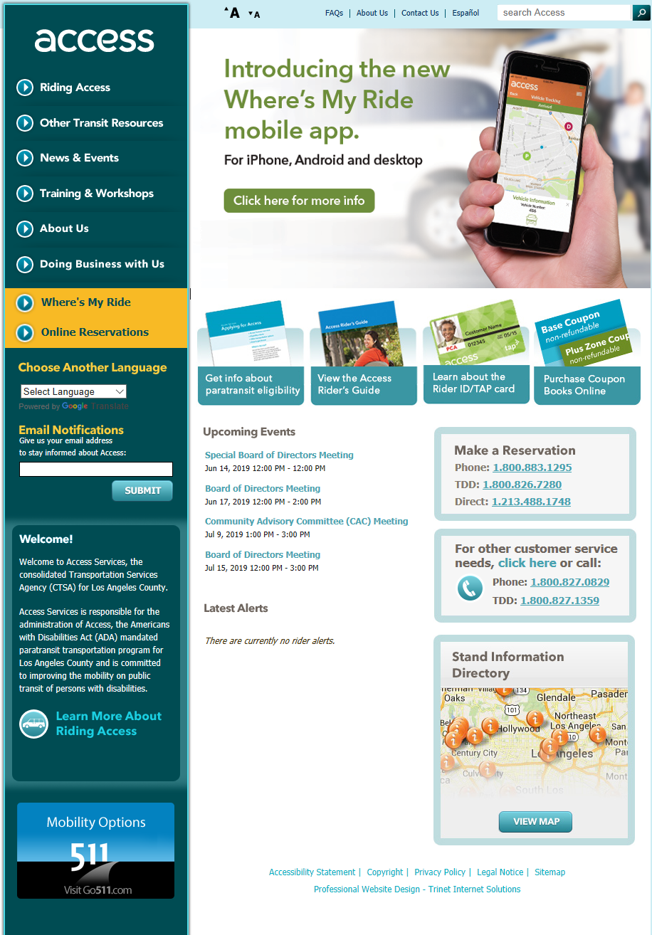
New vs. Existing
Notes:
Applicable federal regulations as interpreted by the courts require that all public fixed route operators must provide or certify there is provided ADA paratransit service complementary to its fixed route and which is designed, funded and implemented to fully meet all projected demand for next-day complementary ADA service. [49 C.F.R. 37.131(b)] The paratransit system must also be operated so as to be free of capacity constraints . [49 C.F.R.37.131(f)] Anderson v. Rochester-Genesee Regional Transp. Authority 337 F.3d 201, 210 -212 (C.A.2 (N.Y.),2003)
For many years Access has used HDR to project ridership.
WHEREAS, since the Americans with Disabilities Act (ADA) requires transit agencies to service all reasonably anticipated demand, Access Services has contracted with HDR Decision Economics to provide ridership projections that are used to recommend funding amounts to meet the annual ADA obligations for Los Angeles County
The assurances in Group 01.F are consistent with the U.S. OMB assurances required in
the U.S. OMB SF-424B and SF-424D, updated as necessary to reflect changes in Federal
laws and regulations.
1. Administrative Activities. On behalf of your Applicant, you assure that:
a. For every Project described in any application it submits, it has adequate
resources to properly plan, manage, and complete its Project, including the:
(1) Legal authority to apply for Federal funding,
(2) Institutional capability,
(3) Managerial capability, and
(4) Financial capability (including funds sufficient to pay the non-Federal share
of Project cost),

Slide 4
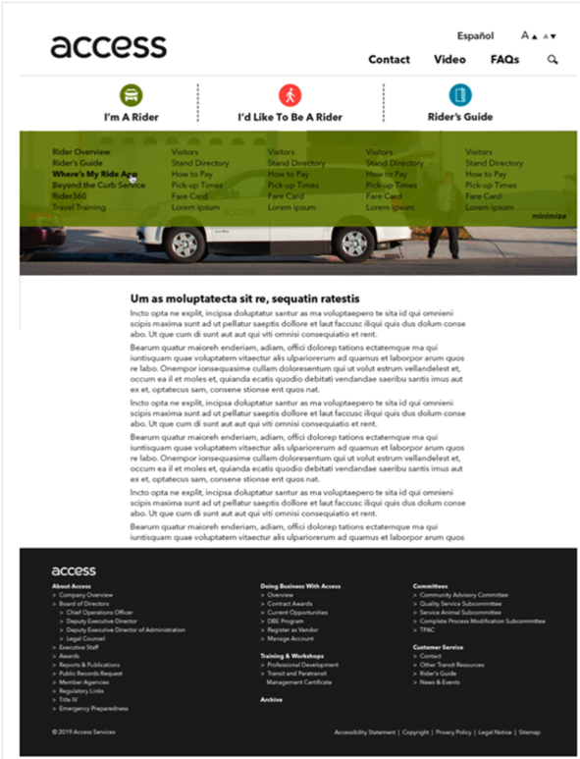
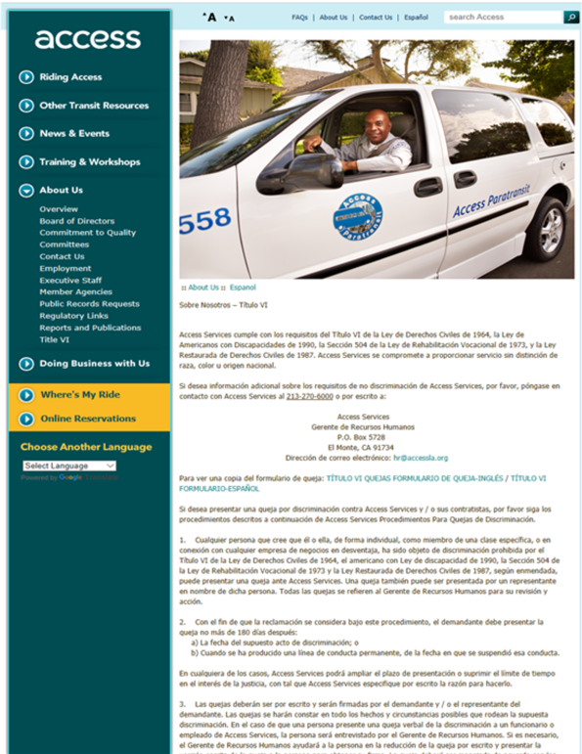
New vs. Existing

Slide 5
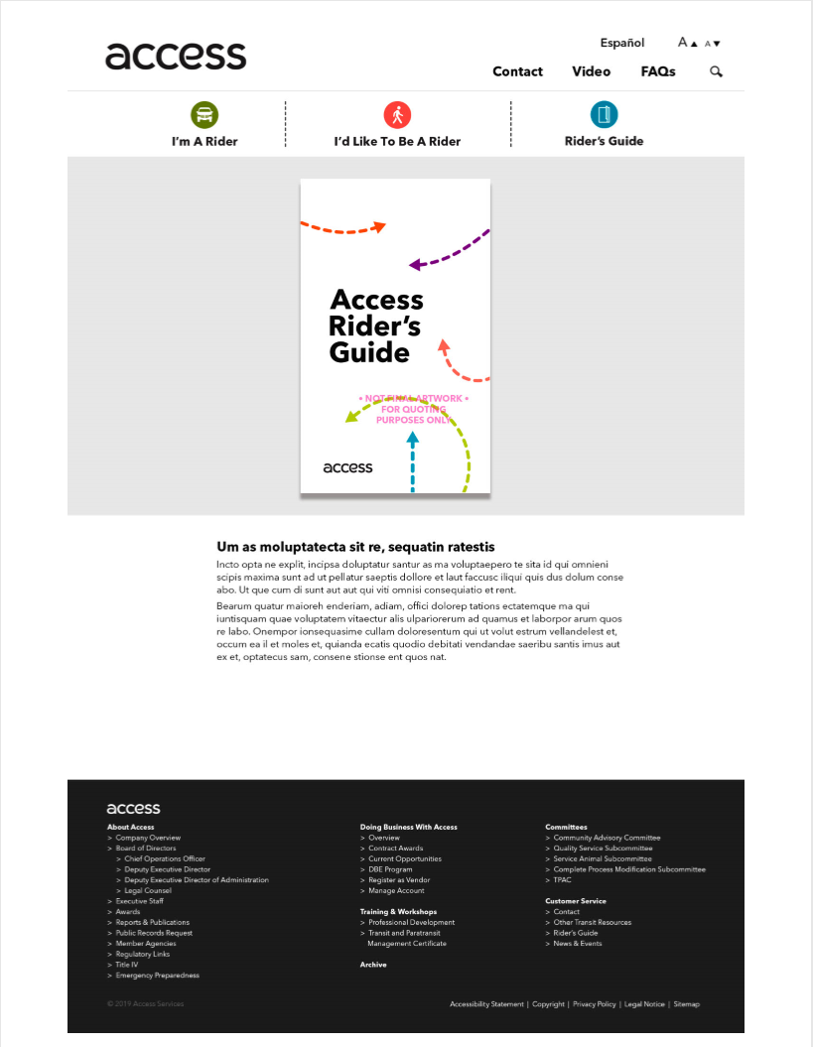
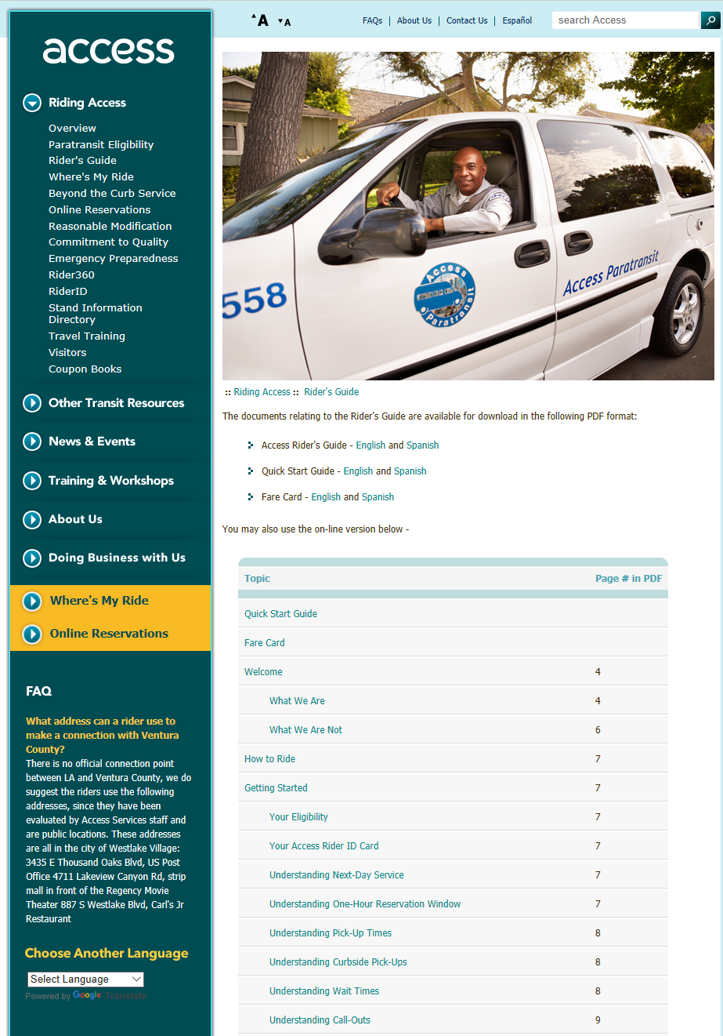
New vs. Existing
Notes:
Applicable federal regulations as interpreted by the courts require that all public fixed route operators must provide or certify there is provided ADA paratransit service complementary to its fixed route and which is designed, funded and implemented to fully meet all projected demand for next-day complementary ADA service. [49 C.F.R. 37.131(b)] The paratransit system must also be operated so as to be free of capacity constraints . [49 C.F.R.37.131(f)] Anderson v. Rochester-Genesee Regional Transp. Authority 337 F.3d 201, 210 -212 (C.A.2 (N.Y.),2003)
For many years Access has used HDR to project ridership.
WHEREAS, since the Americans with Disabilities Act (ADA) requires transit agencies to service all reasonably anticipated demand, Access Services has contracted with HDR Decision Economics to provide ridership projections that are used to recommend funding amounts to meet the annual ADA obligations for Los Angeles County
The assurances in Group 01.F are consistent with the U.S. OMB assurances required in
the U.S. OMB SF-424B and SF-424D, updated as necessary to reflect changes in Federal
laws and regulations.
1. Administrative Activities. On behalf of your Applicant, you assure that:
a. For every Project described in any application it submits, it has adequate
resources to properly plan, manage, and complete its Project, including the:
(1) Legal authority to apply for Federal funding,
(2) Institutional capability,
(3) Managerial capability, and
(4) Financial capability (including funds sufficient to pay the non-Federal share
of Project cost),

Slide 6
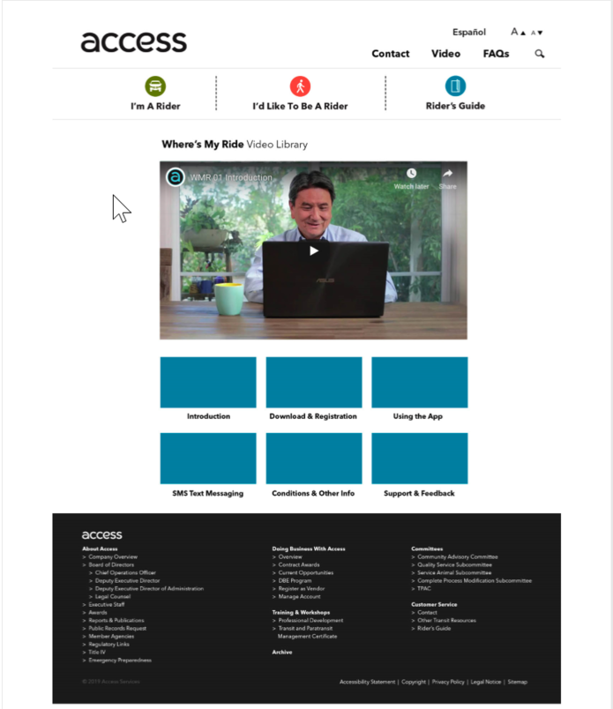
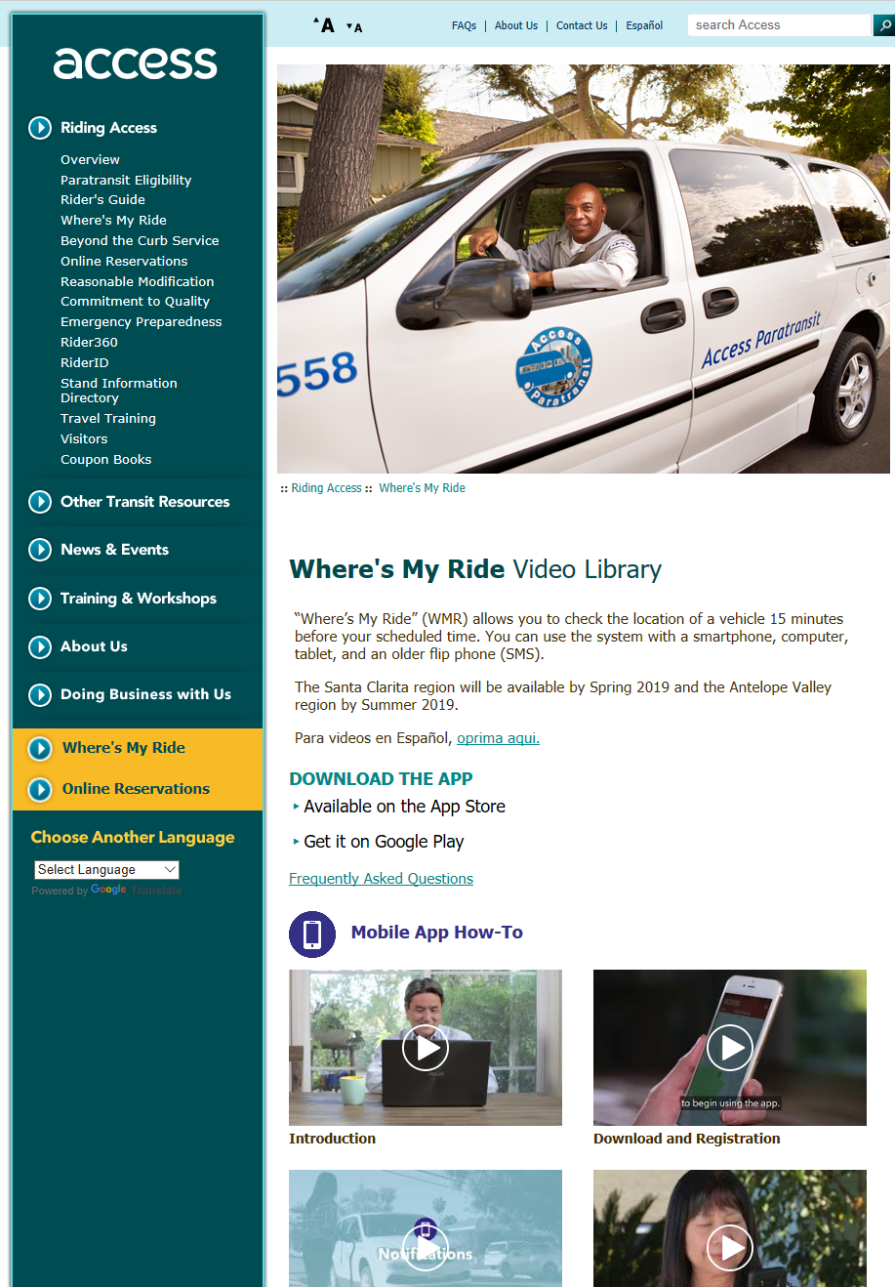
New vs. Existing
Notes:
Applicable federal regulations as interpreted by the courts require that all public fixed route operators must provide or certify there is provided ADA paratransit service complementary to its fixed route and which is designed, funded and implemented to fully meet all projected demand for next-day complementary ADA service. [49 C.F.R. 37.131(b)] The paratransit system must also be operated so as to be free of capacity constraints . [49 C.F.R.37.131(f)] Anderson v. Rochester-Genesee Regional Transp. Authority 337 F.3d 201, 210 -212 (C.A.2 (N.Y.),2003)
For many years Access has used HDR to project ridership.
WHEREAS, since the Americans with Disabilities Act (ADA) requires transit agencies to service all reasonably anticipated demand, Access Services has contracted with HDR Decision Economics to provide ridership projections that are used to recommend funding amounts to meet the annual ADA obligations for Los Angeles County
The assurances in Group 01.F are consistent with the U.S. OMB assurances required in
the U.S. OMB SF-424B and SF-424D, updated as necessary to reflect changes in Federal
laws and regulations.
1. Administrative Activities. On behalf of your Applicant, you assure that:
a. For every Project described in any application it submits, it has adequate
resources to properly plan, manage, and complete its Project, including the:
(1) Legal authority to apply for Federal funding,
(2) Institutional capability,
(3) Managerial capability, and
(4) Financial capability (including funds sufficient to pay the non-Federal share
of Project cost),

